Slide 1
Design Synthesis Exercise
DSE
Workshop PM – SE
2009-2010
Ricky Curran, AMO Michel van Tooren
Rob Hamann SSE Design of Aircraft & Rotorcraft
Aerospace Engineering

Slide 2
Contents
PM/SE workshop, part I
  Project Management
PM/SE workshop, part II
  Systems Engineering
    Functional flow diagram
    Functional break down
    Requirements Discovery Tree
    Technical risk assessment
    Design option analysis
      Design option tree
    Design option analysis
      Preparing for trade-off
      Performing the trade-off
      Presenting trade-off results
    Technical Performance Measurement
    Interface identification – N² Chart
    Presenting your design
    Development logic
    Cost estimate
    List of PM/SE products
PM/SE WS-<number>

Slide 3
Characteristics of Systems Engineering
Top-down process
  Ensures completeness
  Allows for modular design
    Enables parallel development ⇒ shorter time to market
    Provides means to handle complexity
Covers full life cycle
  Optimizes cost
  Requires concurrent engineering approach
PM/SE WS-<number>
Systems Engineering

Slide 4
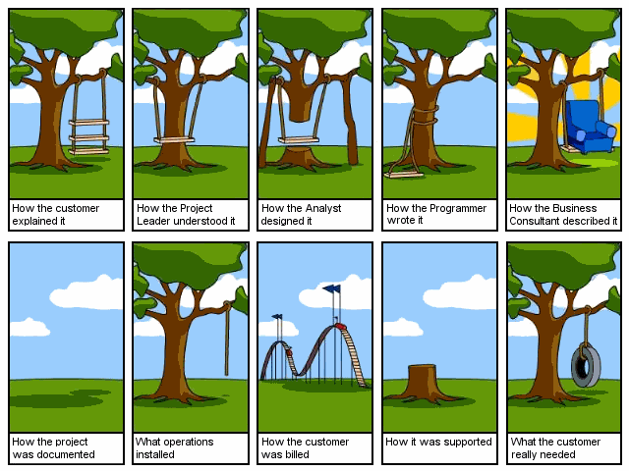
What is the desired product?
PM/SE WS-<number>

Slide 5
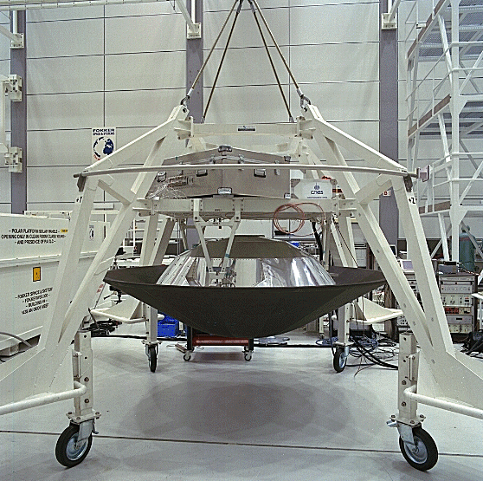
Why: An example
Huygens SM2 test model specification
Background:
The Huygens SM2 was a test model for the probe intended to land on the Saturn moon Titan. As the descent in the (unknown) Titan atmosphere cannot be controlled in real time due to the distance to the planet (it is performed fully automatic), the descent system was to be verified by a (scaled) drop test from 40 km altitude in the earth atmosphere
PM/SE WS-<number>
Systems Engineering
Notes:
Huygens flies on Cassini, an ESA/NASA mission to Saturn and is ment to land on the Saturnus moon Titan. As the descent and deceleration mission is very critical and cannot be commanded in real-time from earth, it was mandatory to obtain representative test data to verify the product.
To this purpose a test model (SM2) has been designed to test the flight hardware in a balloon drop test from 40 km altitude. The model has been instrumented with cameras to monitor parachute deployment and heat shield separation and used GPS to enable trajectory reconstruction.
The test has been sucessful (and the project profitable).

Slide 6
The problem ....
The specification for Huygens SM2 required an Inertial Guidance Package as part of the test model’s equipment
  Major cost driver (multi-M€)
  Unclear use of the package
After lengthy discussions with the customer it was found out that the only essential function was to enable trajectory reconstruction, other functions being covered by other types of sensors
  Same performance achieved with GPS differential mode at 1/20th of the cost
PM/SE WS-<number>
Systems Engineering

Slide 7
Why do products exist?
The justification of a product lies in its use
  A product has no right of existence in itself
The physical appearance of a product is only one of many possible design implementations of the set of functions it is supposed to perform
PM/SE WS-<number>
Functional Analysis

Slide 8
What is a function?
A function is a task or activity to be performed by people, equipment, hardware or software
A function relates to the intended use of a product
PM/SE WS-<number>
Functional Analysis

Slide 9
Functional analysis
Functional analysis helps the engineer to get into the skin of the user or customer
Functional analysis starts with the user’s or customer’s needs (Mission Need Statement;)
Tools for functional analysis
  Functional flow diagram
  Functional break-down
Land a man on the Moon before this decade is out and return him safely to Earth
PM/SE WS-<number>
Functional Analysis

Slide 10
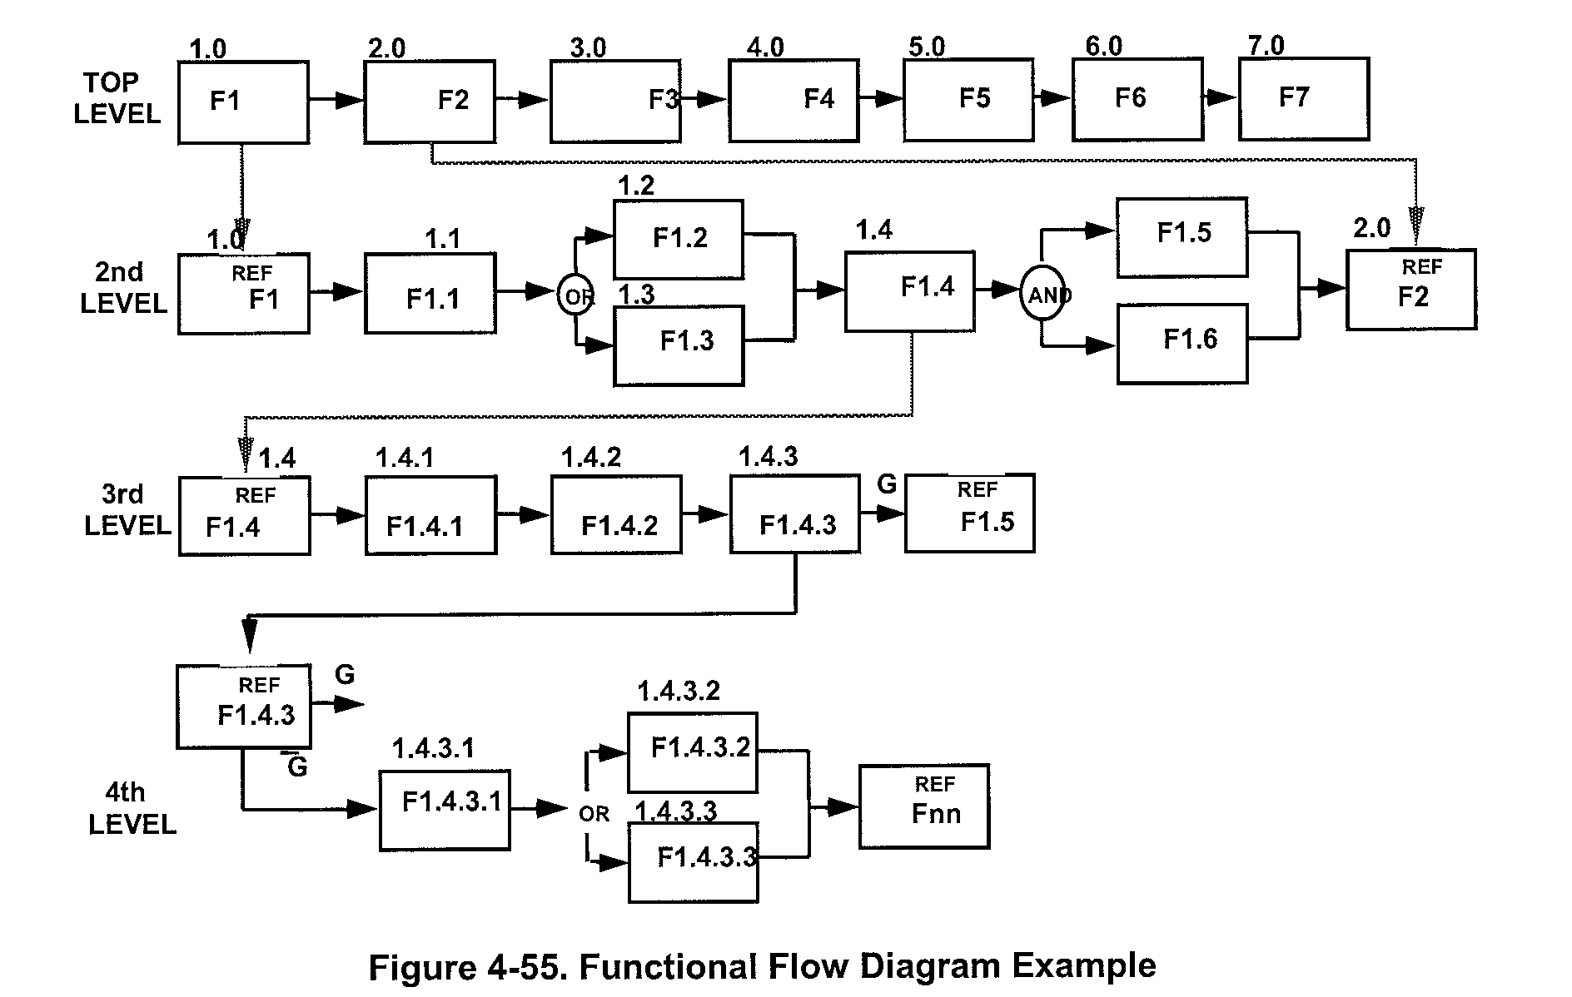
Functional Flow Diagram:
Conventions
PM/SE WS-<number>
Functional Analysis

Slide 11
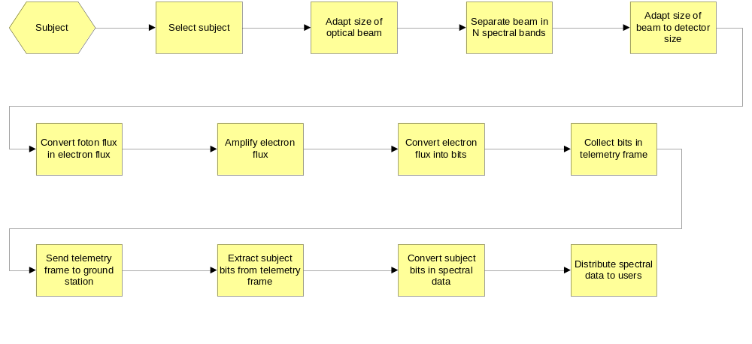
Example: FFD of an instrument for sensing optical spectra
Shows only one level!
PM/SE WS-<number>
Functional Analysis

Slide 12
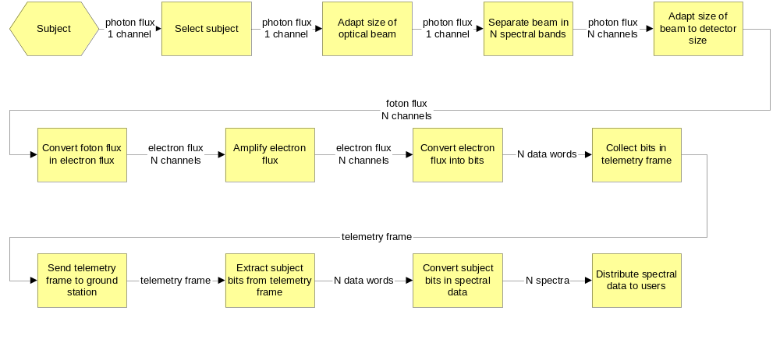
Example: FFD of an instrument for sensing optical spectra
Shows only one level!
PM/SE WS-<number>
Functional Analysis

Slide 13
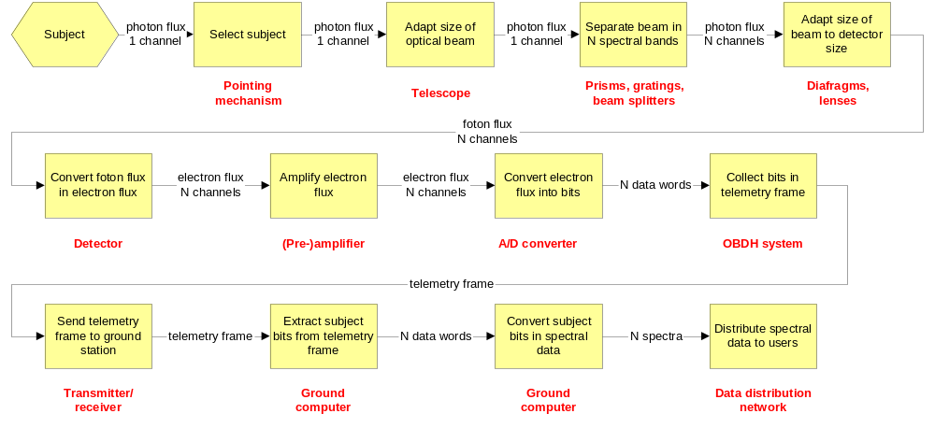
Example: FFD of an instrument for sensing optical spectra
Shows only one level!
PM/SE WS-<number>
Functional Analysis

Slide 14
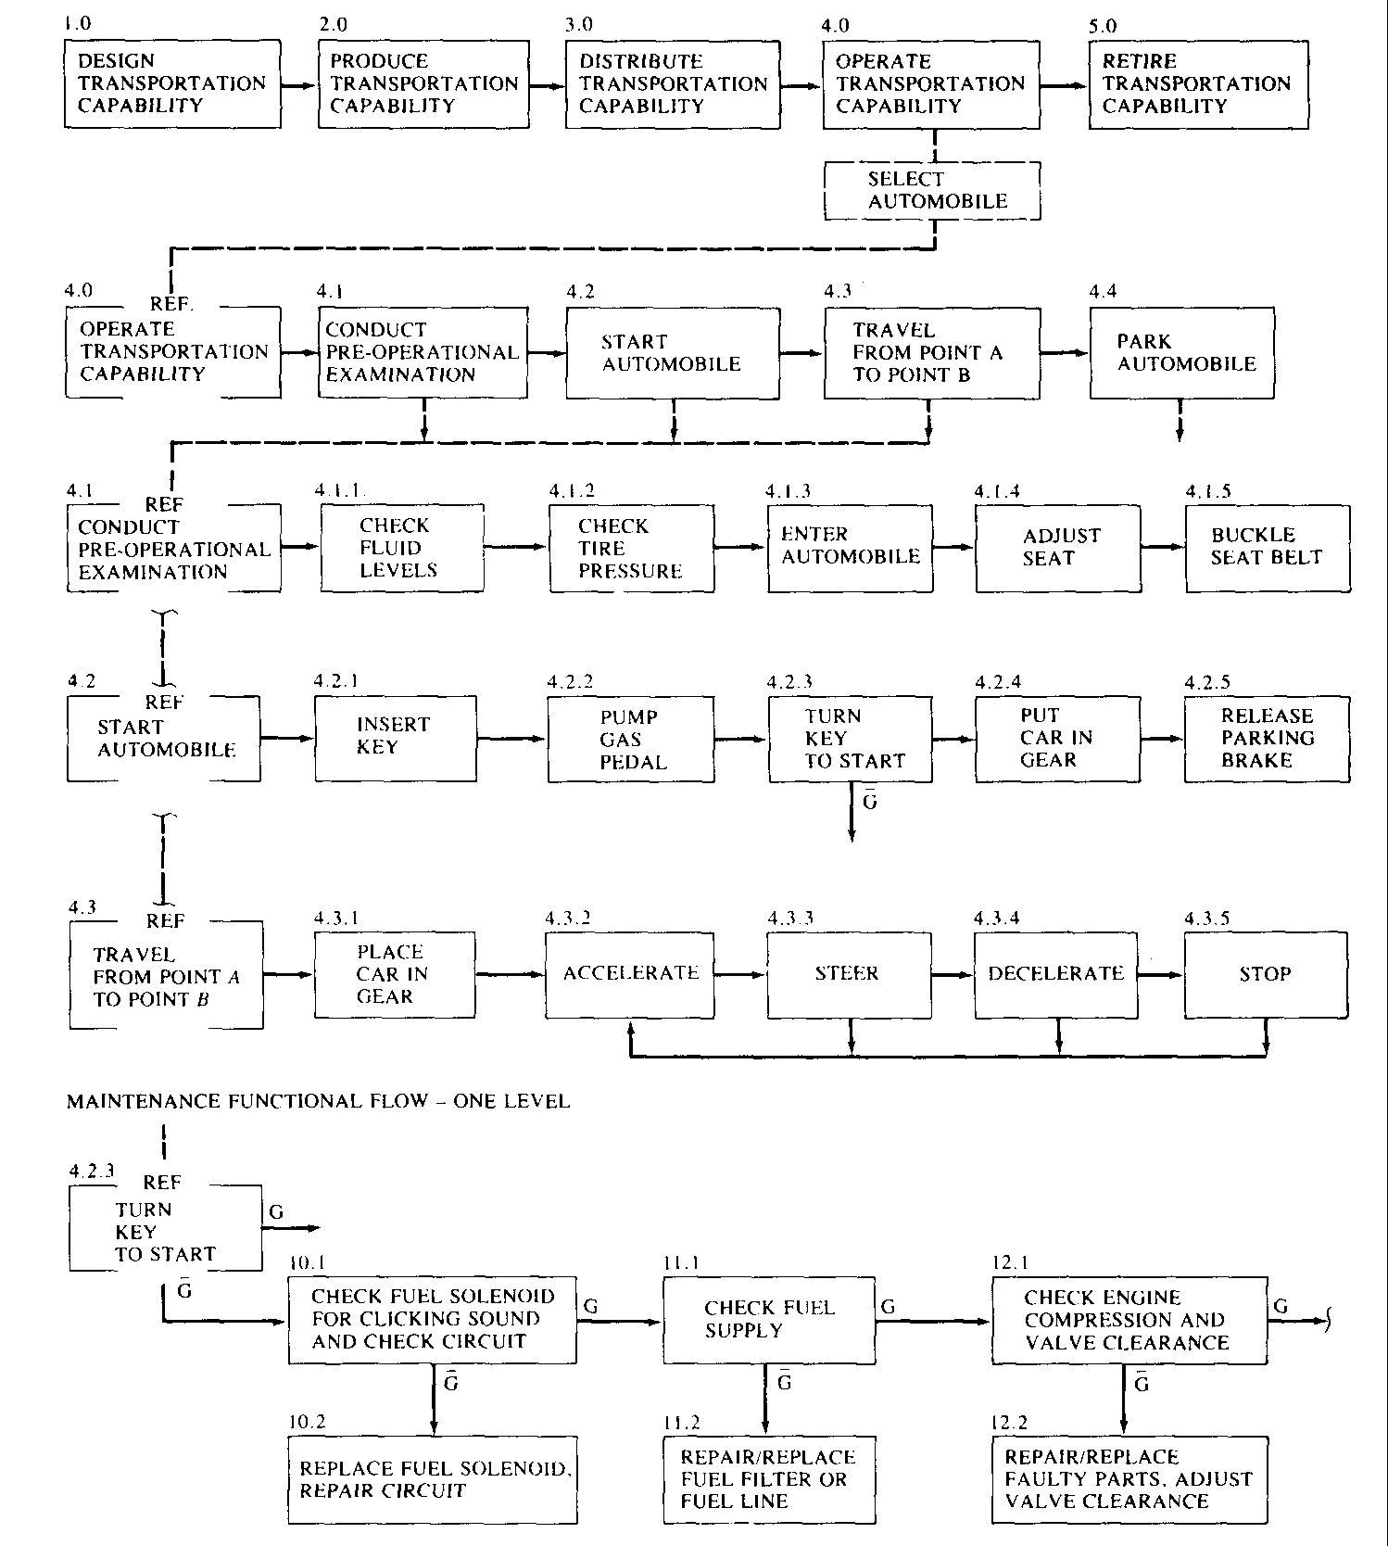
Example:
Automobile system FFD
Could also be called: Operational functional flow diagram
Shows three levels
PM/SE WS-<number>
Functional Analysis

Slide 15
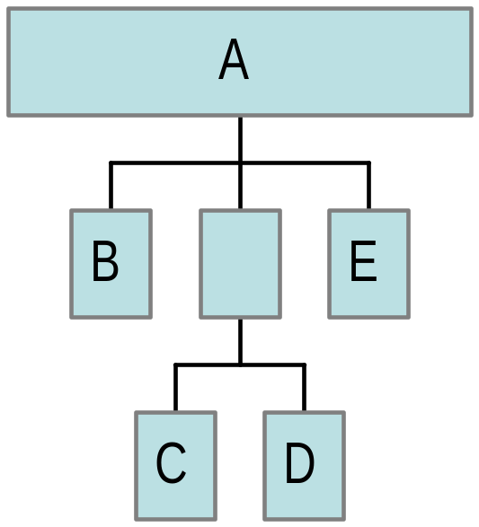
Functional break-down
Logical grouping according to a predetermined set of criteria
  Is a tree, an AND tree, that is:
    Each element of the tree = the sum of the elements below it and nothing more
    A = B + C + D + E
    Gives a complete picture of the system or product
PM/SE WS-<number>
Functional Analysis

Slide 16
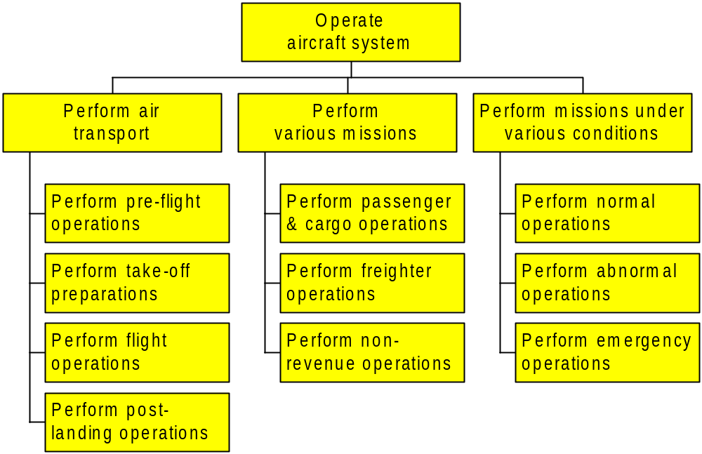
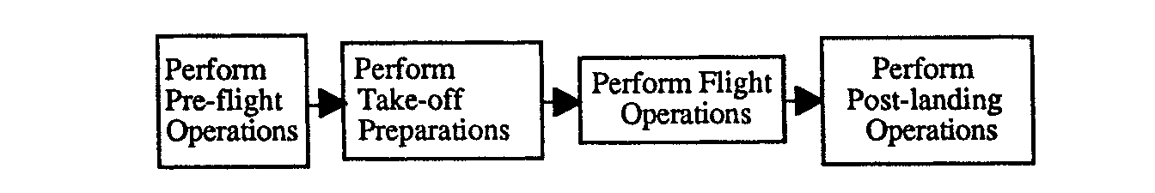
Example: Functional breakdown of an air transport mission
Represented as Functional Flow Diagram
PM/SE WS-<number>
Functional Analysis

Slide 17
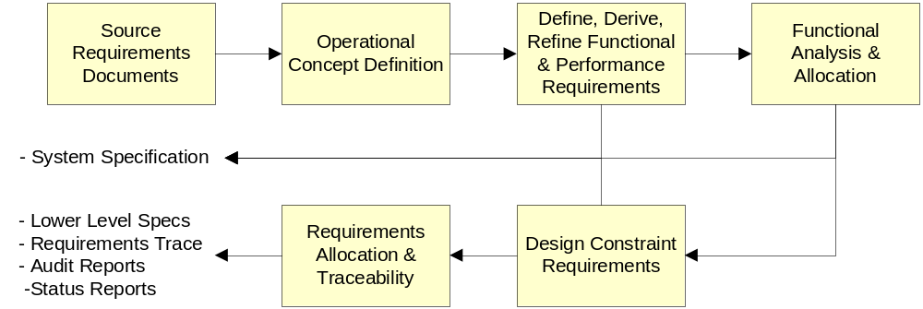
Requirements analysis process
Three steps
  Formulate the Mission (Need) Statement
  Discover the system requirements
  Flow down the subsystem requirements
PM/SE WS-<number>
Requirements Analysis

Slide 18
A tool to help you:
Requirements Discovery Tree
Structured: an AND tree
  Every element is the sum of the elements under it and nothing more
  If true: no requirement has been forgotten
PM/SE WS-<number>
Requirements Analysis

Slide 19
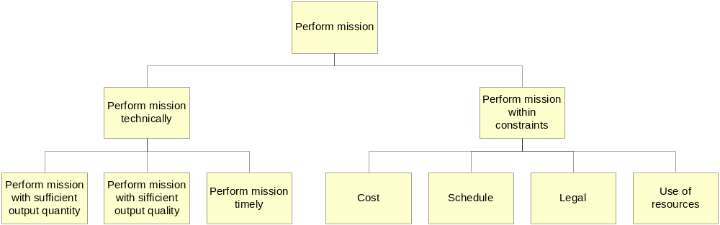
A tool to help you:
Requirements Discovery Tree
Basic guideline: Split requirements up in two parts (dichotomy)
  “Functional requirements” vs. “Constraints”
  “Quality” vs. “Quantity”
  “Geometrical” vs. “Non-geometrical”, etc...
Example
PM/SE WS-<number>
Requirements Analysis

Slide 20
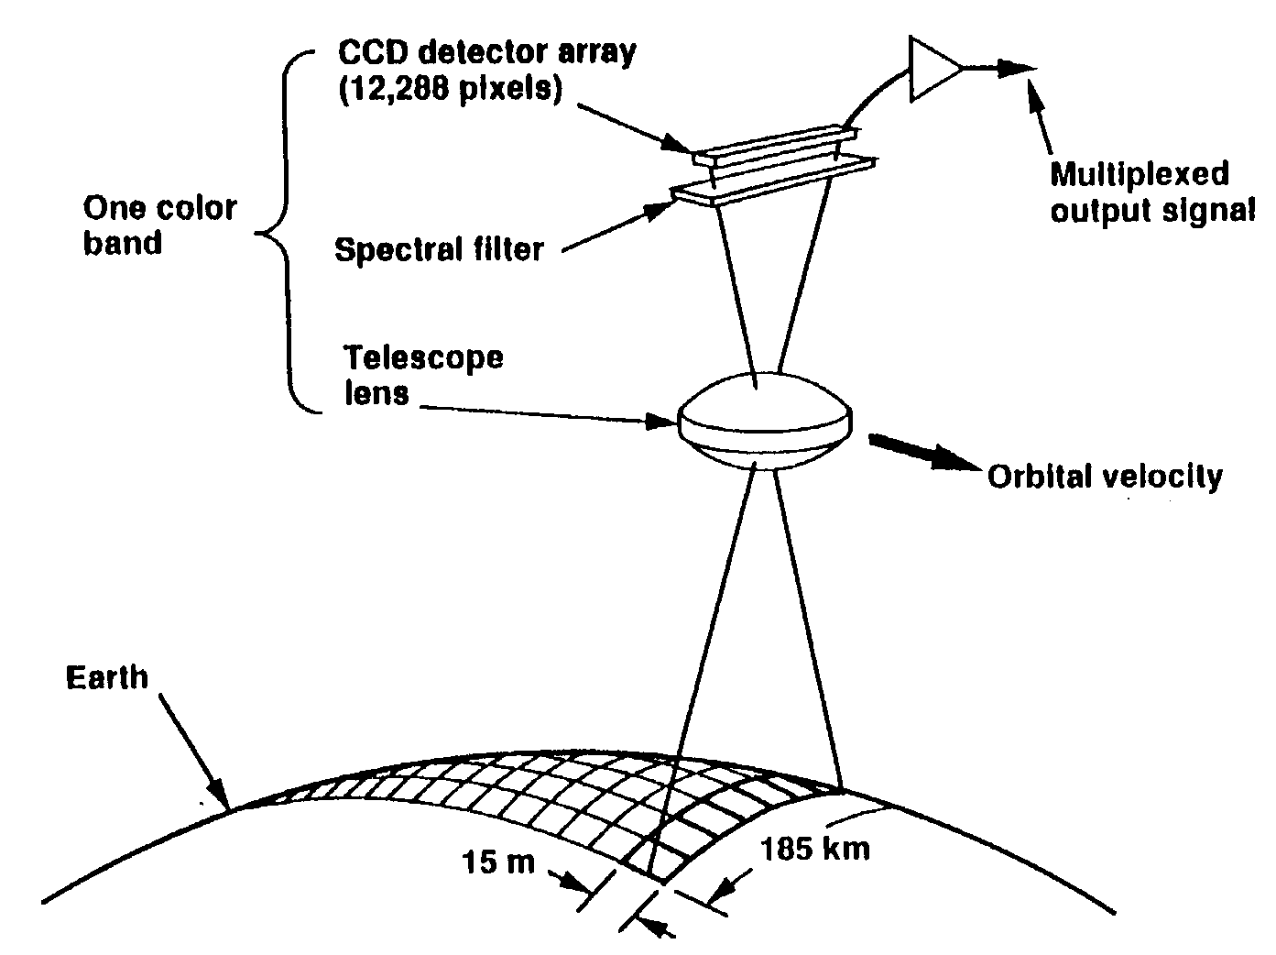
A real-life example: Multi-spectral Linear Array (MLA) instrument
PUSHBROOM SCANNER CONCEPT
PM/SE WS-<number>
Requirements Analysis

Slide 21

MLA Requirements Discovery Tree
PM/SE WS-<number>
Requirements Analysis

Slide 22
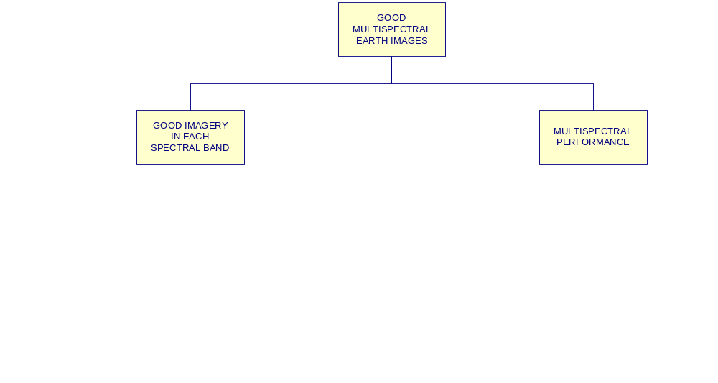
MLA Requirements Discovery Tree
PM/SE WS-<number>
Requirements Analysis

Slide 23
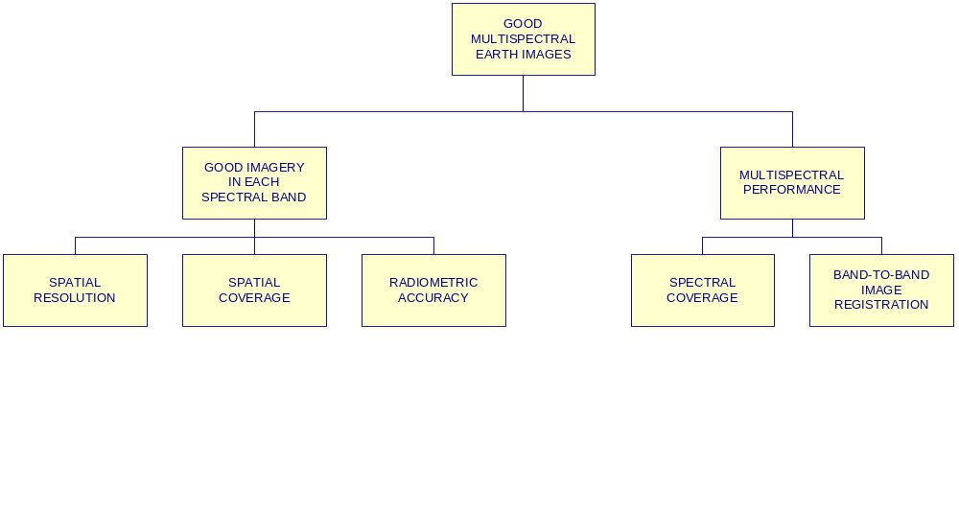
MLA Requirements Discovery Tree
PM/SE WS-<number>
Requirements Analysis

Slide 24
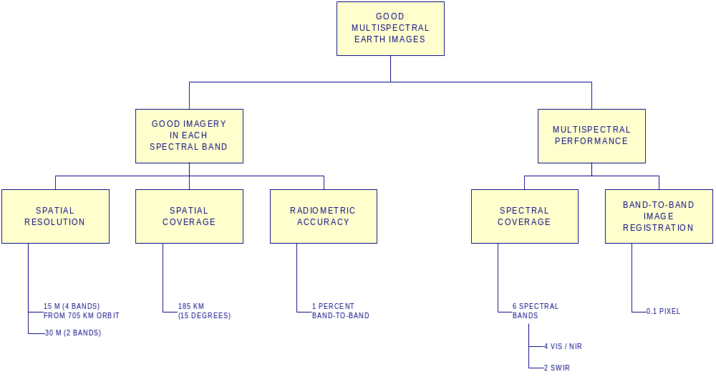
MLA Requirements Discovery Tree
PM/SE WS-<number>
Requirements Analysis

Slide 25
Risk Assessment
Techniques for technical risk assessment
  Identification of (potential) risks
  Assessment of “probability” of occurrence
  Assessment of seriousness of impact on performance, schedule & cost
  Ranking of risks
  Indicating preferred measures for risk reduction
during a product development project
Objective is to spend scarce resources (people, money, time) in those areas where they will achieve the largest reduction in risk
To be most effective, risk assessment shall be an integral part of the (technical) project work
PM/SE WS-<number>
Technical risk assessment

Slide 26
Risk concept
Risk: Measure of uncertainty of attaining a goal, objective, or requirement pertaining to technical performance, cost, and schedule
Risk is always present, e.g.
  Technical performance near the limits of the state of the art ⇒ technical/performance risk
  Product deployment rushed ⇒ schedule risk
  Always funding available is limited ⇒ cost risk
Interdependency
  technical/performance risk ⇒ schedule risk ⇒ cost risk
Risk cannot be removed completely, but can be made negligible
  Set very low technical goals, stretch schedule and provide unlimited funds
But that’s not how the world works!
PM/SE WS-<number>
Technical risk assessment

Slide 27
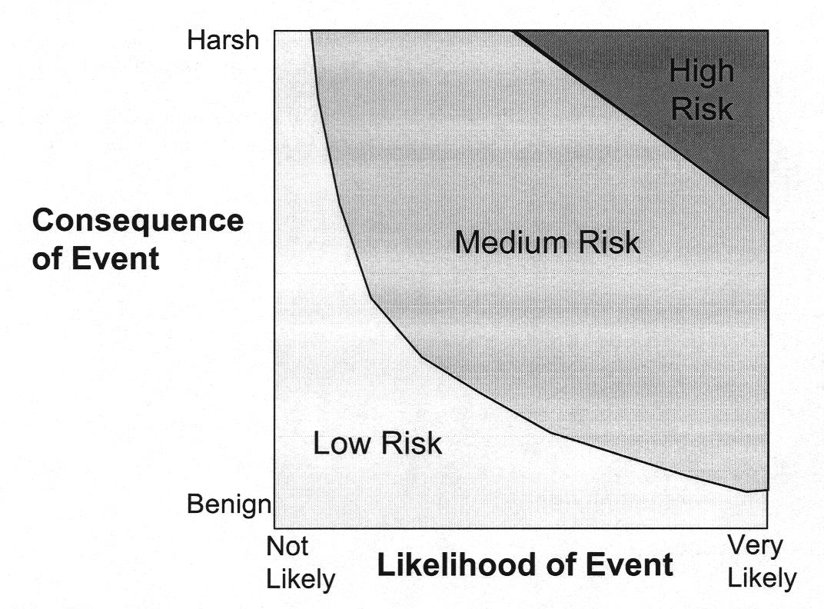
Risk has two dimensions
Required:
  Method to evaluate probability of occurrence or likelihood of event
  Method to evaluate consequence of event or performance consequence
X- and Y-axis are sometimes interchanged
Risk = Likelihood of event * Consequence of event
High
Risk
PM/SE WS-<number>
Technical risk assessment

Slide 28
Evaluate all system elements or functions for both aspects by ordinal scales
Probability of occurrence: is e.g. a function of state of technology or technology maturity
  Proven Flight Design
  Extrapolated from Existing Flight Design
  Based on Existing Non-flight Engineering
  Working Laboratory Model
  Feasible in theory
in order of increasing probability of occurrence
Severity of consequence: may e.g. be expressed as a consequence for the mission or mission criticality
  Catastrophic: mission failure or significant non-achievement of performance
  Critical: mission success is questionable or some reduction in technical performance
  Marginal: Degradation of secondary mission or small reduction in technical performance
  Negligible: inconvenience or non-operational impact
in order of decreasing severity of impact
PM/SE WS-<number>
Technical risk assessment

Slide 29
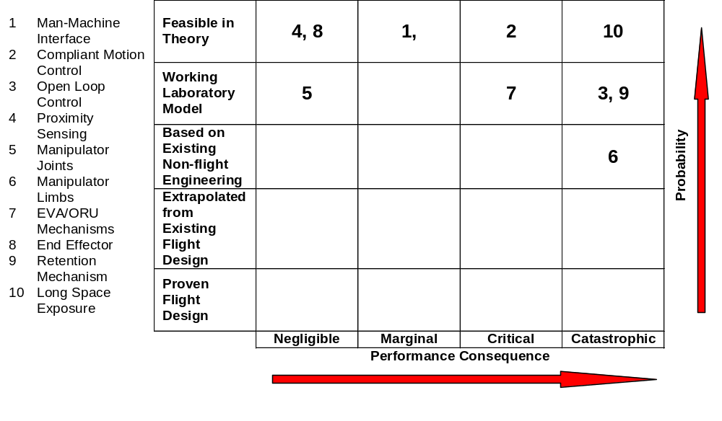
Example: Risk Map Hermes Robot Arm (HERA)
Put scarce resources on these items!
PM/SE WS-<number>
Technical risk assessment

Slide 30
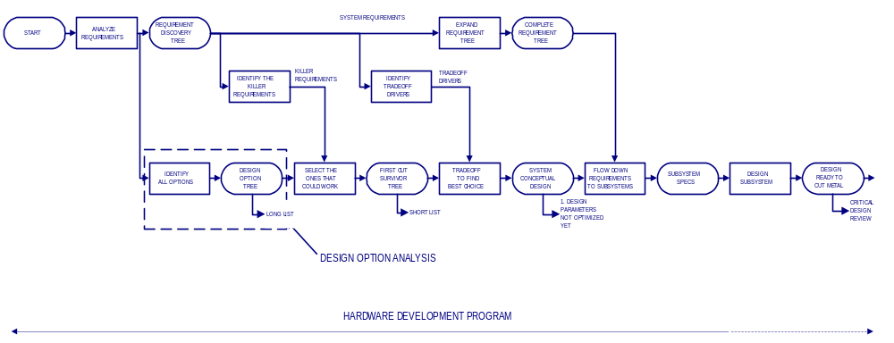
Conceptual Design Process
PM/SE WS-<number>
Design concept selection

Slide 31
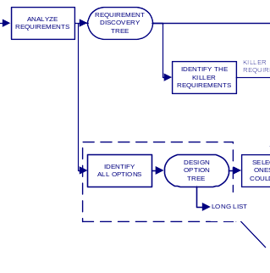
Conceptual Design Process
Design Option Analysis
PM/SE WS-<number>
Design concept selection

Slide 32
Preparing for trade-off (design concept selection)
Prior to trade-off (= selection of preferred option) it is essential to identify all options:
Tool for analysing available design options
  Top-down structure
    Use to identify all possibilities without overlooking any
    Hides detail that would be distracting
  Can organise for efficient decision making
  Aimed at discrete choices, not optimum parameter values
• An or tree
  Each element = one element below it (descendant) and nothing else
  Anything not shown would be descendant of something shown
Use Design Option Tree
PM/SE WS-<number>
Design concept selection

Slide 33
Design Option Tree
Focus on the decisions driven by killer requirements
  Decisions uniquely tied to success of failure
  Make “ordinary” decisions after the hard ones
  Top-down structured approach to decision making
Can be called a “trade tree”
  Shows options (and possibly decision), not trade-off rationale
  Not a “decision tree”
    Decision tree shows figure of merit computed for each branch
PM/SE WS-<number>
Design concept selection

Slide 34
A real-life example: Multi-spectral Linear Array (MLA) instrument
6 spectral bands
PUSHBROOM SCANNER CONCEPT
Problem: How do we choose a design that ensures good alignment of the images in 6 spectral bands?
PM/SE WS-<number>
Design concept selection

Slide 35
MLA Requirement Tree
PM/SE WS-<number>
Design concept selection

Slide 36
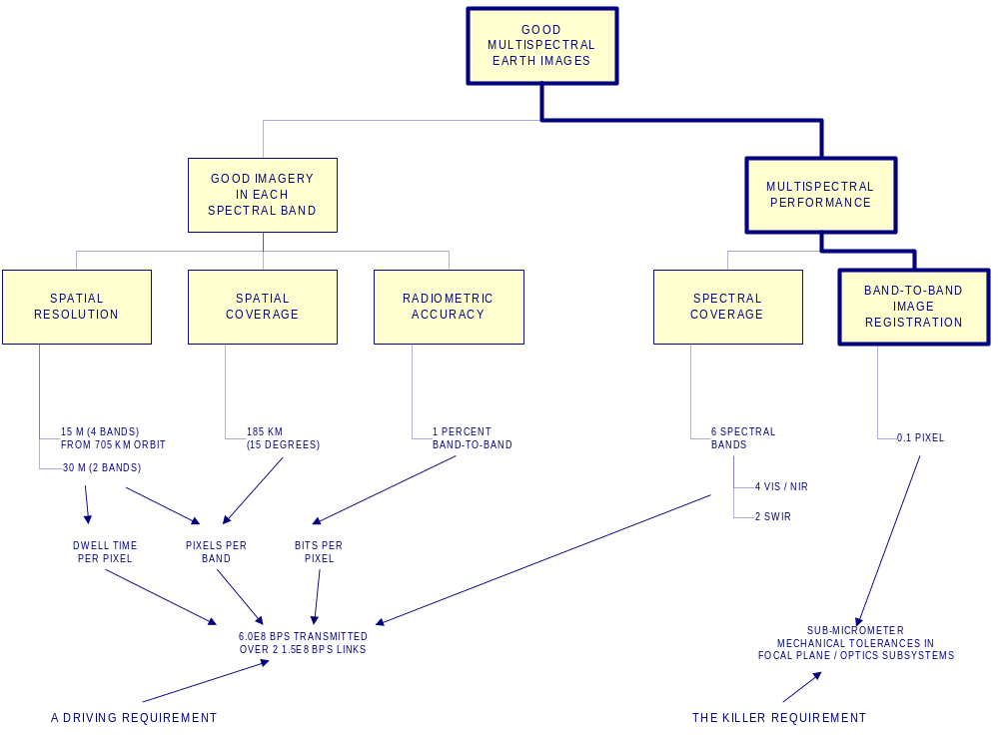
MLA Killer Requirement
PM/SE WS-<number>
Design concept selection

Slide 37

Design Option Tree (Trade Tree)
PM/SE WS-<number>
Design concept selection
Notes:
DESIGN OPTION TREE (TRADE TREE)
This is an or tree in the sense that each block can be satisfied by any one of the blocks below it, and in no other possible way. It is an amazingly useful tool for identifying all possible solutions to the problem, provided that you are willing to put down even the obviously silly ones.
This particular example addresses the first design trade-off of the MLA program - selecting the configuration that would best meet the killer registration requirement. It was “obvious” to everyone that since the existing system on LANDSAT used a single telescope, this was the only possible approach. But when we considered all optically (that is, mechanically) registered configurations, we saw that other things were possible as well.
As we examined various optical/mechanical options and saw how frightening the tolerances were, we backed off one more level and decided that what we really needed was aligned images, not aligned optics. To be sure that we would come up with a truly usable system, we had to look beyond the requirements that our customer had included in his specification for the sensor subsystem. We knew of the huge computer bottlenecks and backlogs of the LANDSAT program, we added “without delays” to the registered images requirement, and postulated the possibility of some electronic solution.
Again, it is mandatory to follow the tree or logic rigorously. This means including all the possible options, even the ones you’re sure won’t work. If they really won’t work, that will become clear in the next step of narrowing things down. But the tree is still complete at each level.
Note that we’re calling this an option tree, not a decision tree. the term decision tree usually refers to an option tree for which a figure of merit (e.g., cost or probability of success) is computed for each branch. This is a semiautomatic decision-making tool, and is very nice in those situations in which such a figure of merit can be defined that truly corresponds to the goal of the decision to be made. The option tree is simpler and usable in more situations.

Slide 38
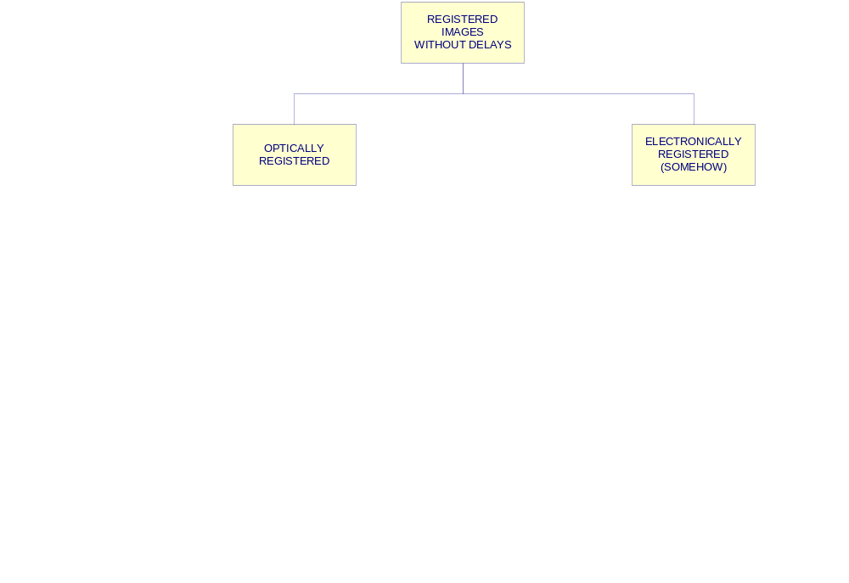
Design Option Tree (Trade Tree)
PM/SE WS-<number>
Design concept selection
Notes:
DESIGN OPTION TREE (TRADE TREE)
This is an or tree in the sense that each block can be satisfied by any one of the blocks below it, and in no other possible way. It is an amazingly useful tool for identifying all possible solutions to the problem, provided that you are willing to put down even the obviously silly ones.
This particular example addresses the first design trade-off of the MLA program - selecting the configuration that would best meet the killer registration requirement. It was “obvious” to everyone that since the existing system on LANDSAT used a single telescope, this was the only possible approach. But when we considered all optically (that is, mechanically) registered configurations, we saw that other things were possible as well.
As we examined various optical/mechanical options and saw how frightening the tolerances were, we backed off one more level and decided that what we really needed was aligned images, not aligned optics. To be sure that we would come up with a truly usable system, we had to look beyond the requirements that our customer had included in his specification for the sensor subsystem. We knew of the huge computer bottlenecks and backlogs of the LANDSAT program, we added “without delays” to the registered images requirement, and postulated the possibility of some electronic solution.
Again, it is mandatory to follow the tree or logic rigorously. This means including all the possible options, even the ones you’re sure won’t work. If they really won’t work, that will become clear in the next step of narrowing things down. But the tree is still complete at each level.
Note that we’re calling this an option tree, not a decision tree. the term decision tree usually refers to an option tree for which a figure of merit (e.g., cost or probability of success) is computed for each branch. This is a semiautomatic decision-making tool, and is very nice in those situations in which such a figure of merit can be defined that truly corresponds to the goal of the decision to be made. The option tree is simpler and usable in more situations.

Slide 39
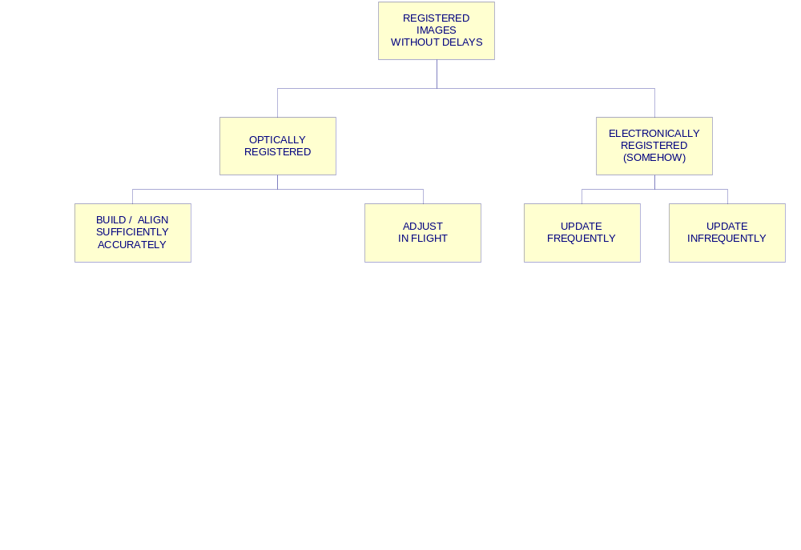
Design Option Tree (Trade Tree)
PM/SE WS-<number>
Design concept selection
Notes:
DESIGN OPTION TREE (TRADE TREE)
This is an or tree in the sense that each block can be satisfied by any one of the blocks below it, and in no other possible way. It is an amazingly useful tool for identifying all possible solutions to the problem, provided that you are willing to put down even the obviously silly ones.
This particular example addresses the first design trade-off of the MLA program - selecting the configuration that would best meet the killer registration requirement. It was “obvious” to everyone that since the existing system on LANDSAT used a single telescope, this was the only possible approach. But when we considered all optically (that is, mechanically) registered configurations, we saw that other things were possible as well.
As we examined various optical/mechanical options and saw how frightening the tolerances were, we backed off one more level and decided that what we really needed was aligned images, not aligned optics. To be sure that we would come up with a truly usable system, we had to look beyond the requirements that our customer had included in his specification for the sensor subsystem. We knew of the huge computer bottlenecks and backlogs of the LANDSAT program, we added “without delays” to the registered images requirement, and postulated the possibility of some electronic solution.
Again, it is mandatory to follow the tree or logic rigorously. This means including all the possible options, even the ones you’re sure won’t work. If they really won’t work, that will become clear in the next step of narrowing things down. But the tree is still complete at each level.
Note that we’re calling this an option tree, not a decision tree. the term decision tree usually refers to an option tree for which a figure of merit (e.g., cost or probability of success) is computed for each branch. This is a semiautomatic decision-making tool, and is very nice in those situations in which such a figure of merit can be defined that truly corresponds to the goal of the decision to be made. The option tree is simpler and usable in more situations.

Slide 40
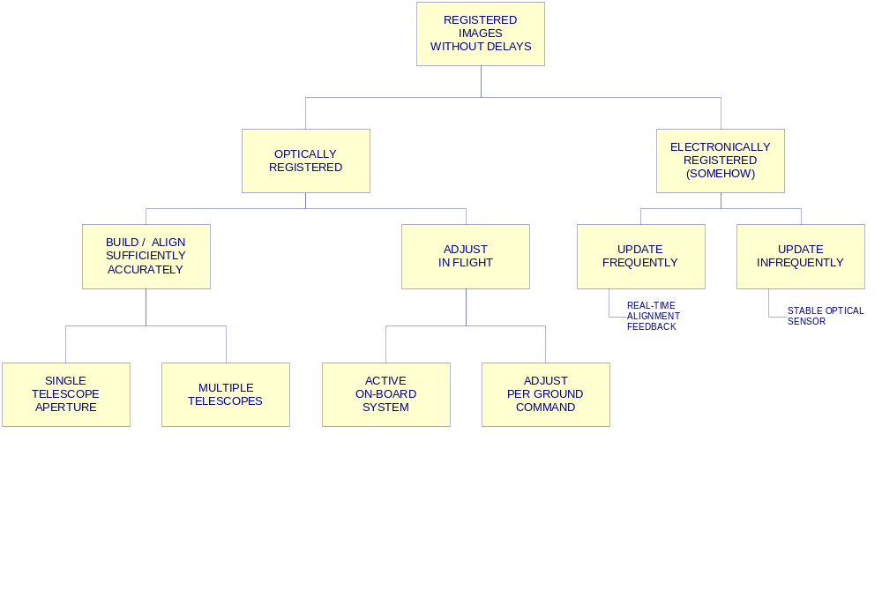
Design Option Tree (Trade Tree)
PM/SE WS-<number>
Design concept selection
Notes:
DESIGN OPTION TREE (TRADE TREE)
This is an or tree in the sense that each block can be satisfied by any one of the blocks below it, and in no other possible way. It is an amazingly useful tool for identifying all possible solutions to the problem, provided that you are willing to put down even the obviously silly ones.
This particular example addresses the first design trade-off of the MLA program - selecting the configuration that would best meet the killer registration requirement. It was “obvious” to everyone that since the existing system on LANDSAT used a single telescope, this was the only possible approach. But when we considered all optically (that is, mechanically) registered configurations, we saw that other things were possible as well.
As we examined various optical/mechanical options and saw how frightening the tolerances were, we backed off one more level and decided that what we really needed was aligned images, not aligned optics. To be sure that we would come up with a truly usable system, we had to look beyond the requirements that our customer had included in his specification for the sensor subsystem. We knew of the huge computer bottlenecks and backlogs of the LANDSAT program, we added “without delays” to the registered images requirement, and postulated the possibility of some electronic solution.
Again, it is mandatory to follow the tree or logic rigorously. This means including all the possible options, even the ones you’re sure won’t work. If they really won’t work, that will become clear in the next step of narrowing things down. But the tree is still complete at each level.
Note that we’re calling this an option tree, not a decision tree. the term decision tree usually refers to an option tree for which a figure of merit (e.g., cost or probability of success) is computed for each branch. This is a semiautomatic decision-making tool, and is very nice in those situations in which such a figure of merit can be defined that truly corresponds to the goal of the decision to be made. The option tree is simpler and usable in more situations.

Slide 41
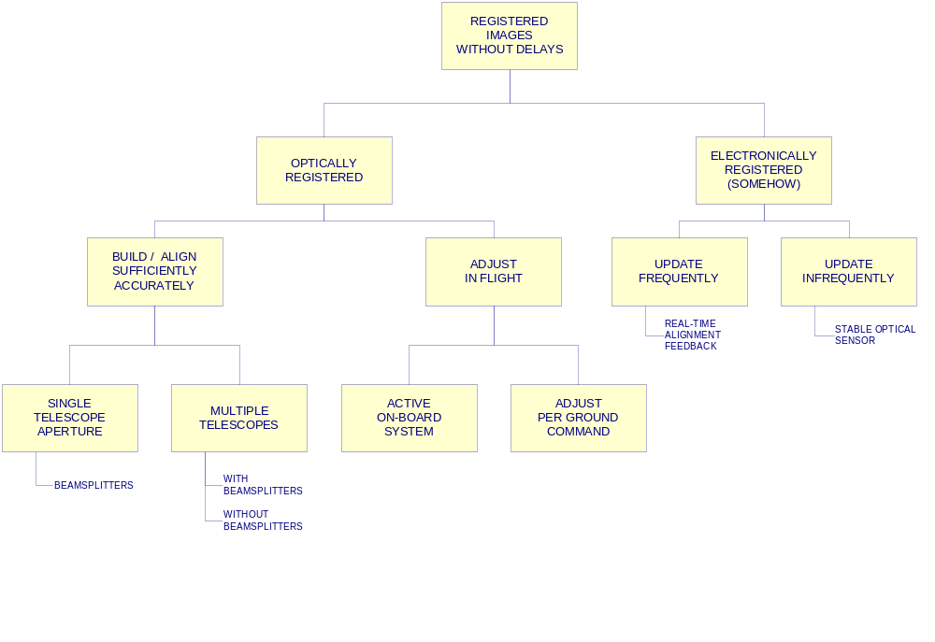
Design Option Tree (Trade Tree)
PM/SE WS-<number>
Design concept selection
Notes:
DESIGN OPTION TREE (TRADE TREE)
This is an or tree in the sense that each block can be satisfied by any one of the blocks below it, and in no other possible way. It is an amazingly useful tool for identifying all possible solutions to the problem, provided that you are willing to put down even the obviously silly ones.
This particular example addresses the first design trade-off of the MLA program - selecting the configuration that would best meet the killer registration requirement. It was “obvious” to everyone that since the existing system on LANDSAT used a single telescope, this was the only possible approach. But when we considered all optically (that is, mechanically) registered configurations, we saw that other things were possible as well.
As we examined various optical/mechanical options and saw how frightening the tolerances were, we backed off one more level and decided that what we really needed was aligned images, not aligned optics. To be sure that we would come up with a truly usable system, we had to look beyond the requirements that our customer had included in his specification for the sensor subsystem. We knew of the huge computer bottlenecks and backlogs of the LANDSAT program, we added “without delays” to the registered images requirement, and postulated the possibility of some electronic solution.
Again, it is mandatory to follow the tree or logic rigorously. This means including all the possible options, even the ones you’re sure won’t work. If they really won’t work, that will become clear in the next step of narrowing things down. But the tree is still complete at each level.
Note that we’re calling this an option tree, not a decision tree. the term decision tree usually refers to an option tree for which a figure of merit (e.g., cost or probability of success) is computed for each branch. This is a semiautomatic decision-making tool, and is very nice in those situations in which such a figure of merit can be defined that truly corresponds to the goal of the decision to be made. The option tree is simpler and usable in more situations.

Slide 42
Completeness vs. Detail
Tree must be complete to be useful
  Each element = one (or more) descendant and nothing else
  Requires rigorous logic
  Impossible to omit anything!
Use “anything else” as temporary placeholder
  Keeps you from getting stuck during thinking process
  Must eventually be replaced by specifics or removed
Include every possibility you can identify
  Tried and true solutions
  Reasonable alternatives
  Apparently silly (but theoretically possible) alternatives
  Things you can name but for which you do not yet have specific concept
Importance of looking for alternatives to “tried and true” depends on how successful the usual solution is
You may need to do this privately to do it honestly!
PM/SE WS-<number>
Design concept selection

Slide 43
Organizing Option Tree for Efficient Selection
Use scientific method to disprove usefulness of options
  Test against killer requirements, laws of physics, etc.
  “No-go” decision prunes all descendants from tree
Tree can be organised many ways
  Look for common traits that may drive decision
  Can group options with that trait in one branch
Place suspected weak points high in tree
  One calculation can “prune” large areas of tree at once
    Eliminated as not feasible
    Eliminated as inferior to alternative
    (Be careful that trade-off at this level would not be invalidated by information from some lower level)
  Don’t bother extending tree (adding detail) below suspected weak point until you have checked feasibility
PM/SE WS-<number>
Design concept selection

Slide 44
Organizing Option Tree for Efficient Selection (Concluded)
Can be used to identify a needed invention
  If all options are ruled out (or very ugly), you’re stuck
  Postulate new device (process, etc.) If it opens up possibilities
  Verify feasibility of developing new item if benefit is large enough
  Example: pipeline re-sampling processor makes MLA system practical
PM/SE WS-<number>
Design concept selection

Slide 45
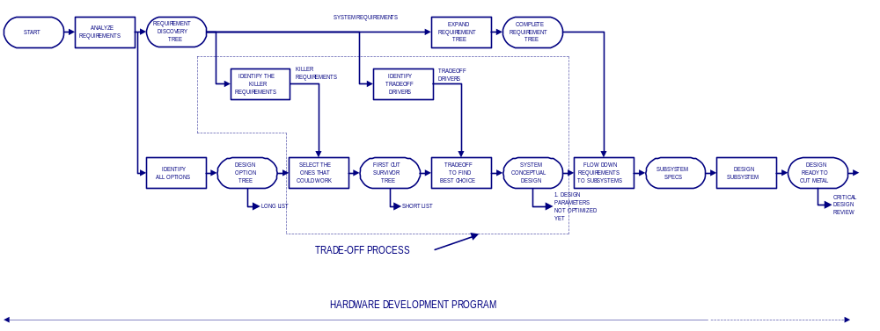
Conceptual Design Process
PM/SE WS-<number>
Design concept selection

Slide 46
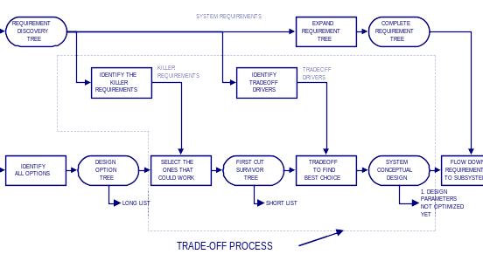
Conceptual Design Process
PM/SE WS-<number>
Design concept selection

Slide 47
Guidelines for Doing the Trade-off
Every project is unique
  Adequacy of present state of the art
  Time and resources available for conceptual design phase
  Relative importance of innovation vs. Here-and-now practicality
Pattern given here will be helpful
  Must be tailored for you specific situation
  Realism, good judgement, common sense must prevail
PM/SE WS-<number>
Design concept selection

Slide 48
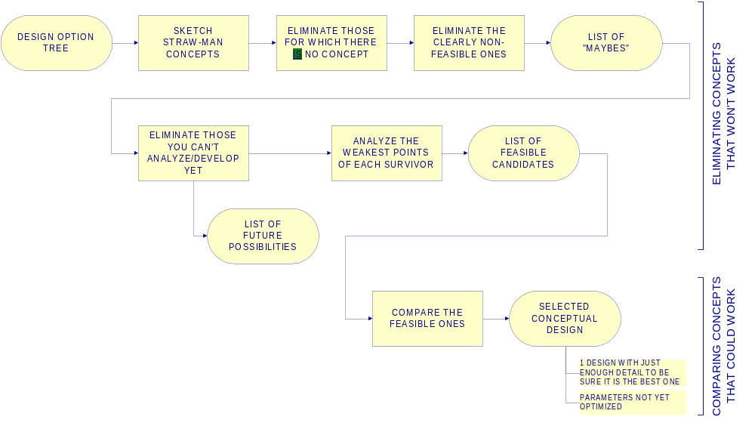
Guidelines for Doing the Trade-off
PM/SE WS-<number>
Design concept selection

Slide 49
Strawman Design Concepts
You need specific concepts to think about
  Representative(s) of each major branch of the option tree
  Enough detail and realism to enable you to see what the questions are
  Growing insight may show you how to redraw the option tree to be more useful
Usually many of the concepts are very familiar
  “Tried and true” designs
  Your customer’s favourite design
  Your employer’s standard design
New concepts may be needed
  For exotic problems that don’t have standard solutions
  Alternatives to the “tried and true” if they might offer advantages
  Many sources of ideas available to you
    Experts or inventive people
    Journals, other literature
    Experience, general curiosity, everything you’ve ever seen or heard of
PM/SE WS-<number>
Design concept selection

Slide 50
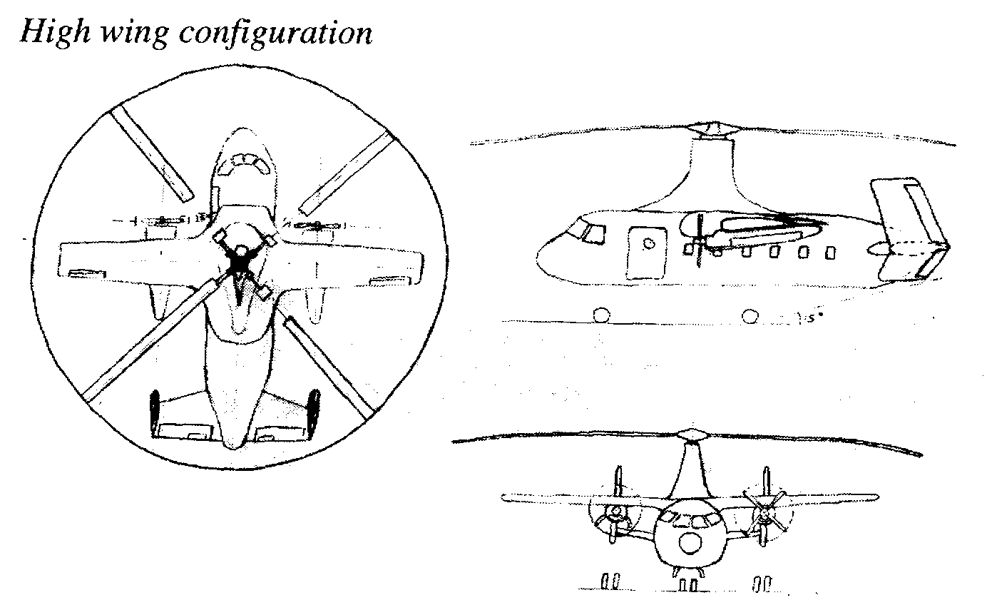
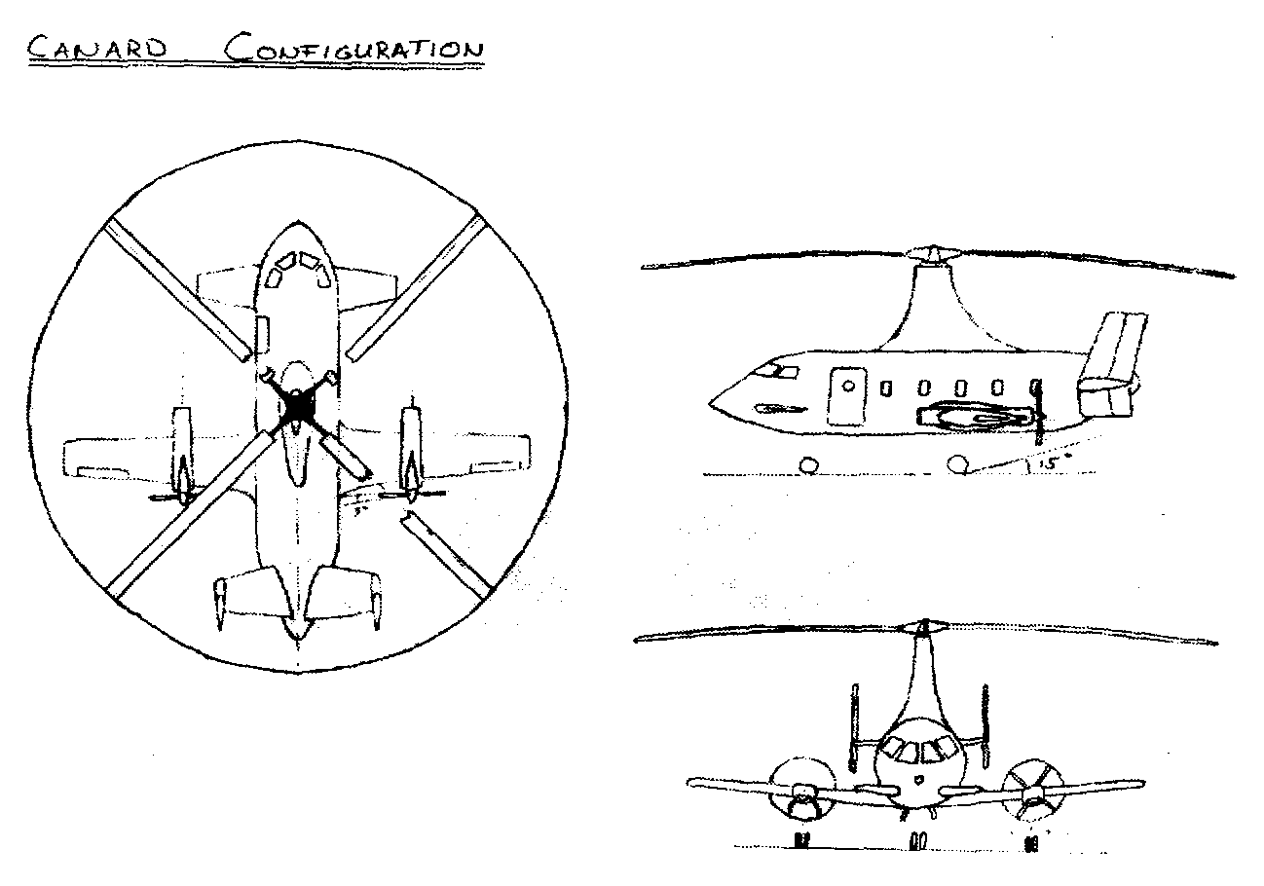
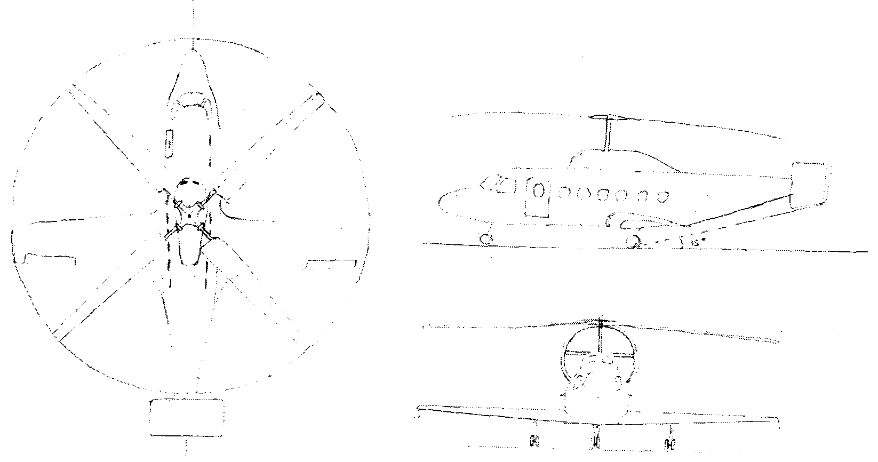
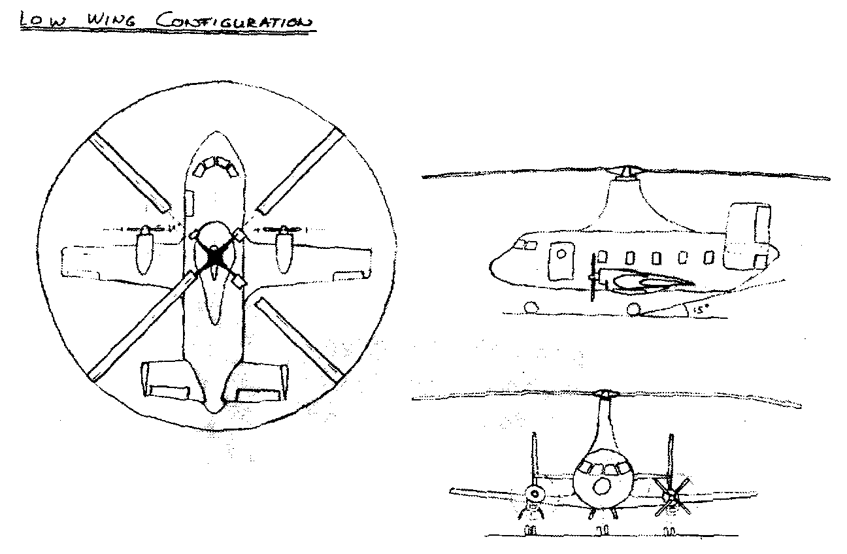
Concepts may be simply defined ….
Rear thrust configuration
Source: DSE “A new look at the autogyro”
PM/SE WS-<number>
Design concept selection

Slide 51
Eliminating the Obvious Losers
Eliminate the non-concepts
  Things you named for the sake of completeness but for which you can’t find an implementation
  Ideas that looked good initially but melt away in the cold light of day
Eliminate the obviously non-feasible ones
  Things forbidden by the laws of nature
  Things that grossly violate practicality
Write down what you’ve eliminated and why, so you (and your customer) can double-check your logic later on
  Someone may point out something wrong with your logic
  Technology or requirements may change so that your conclusion needs to be revised
Output: list of “maybes”
PM/SE WS-<number>
Design concept selection

Slide 52
Eliminating Those that Can’t Be Analyzed / Developed Yet
Concepts that might be workable but are not worth pursuing now
  New technology you don’t have time or resources to develop now
  Things that are too difficult to analyse within your schedule
  Other concepts already in hand seem adequate
Record these as a list of candidates for future investigation
  Gives you and your customer a way of double-checking your logic
  Useful fallback positions if the selected concept gets into trouble later on
  May be an important input for a research study
Output: List of future possibilities
PM/SE WS-<number>
Design concept selection

Slide 53
Analyzing the Weak Points of the Survivors
Analyse the weakest point(s) of each surviving candidate
  Understand the governing principles
  Find the one or two things most likely to keep this concept from working
  Gather necessary data on components, materials, etc.
  Do calculations necessary to try to prove it can’t work
Example:
  Concept X looks too heavy
  Analyse weight of X
  Eliminate X as infeasible if weight exceeds some hard constraint
Will give you insight you need for the final selection
  Eliminates all but the truly feasible concepts
  If X is feasible, include weight among trade-off criteria
  May identify unexpected trade-off driver requirements or issues
Focusing on the weak points can guide you through the selection process efficiently
Output: List of feasible candidates
PM/SE WS-<number>
Design concept selection

Slide 54
Design Option Tree (Trade Tree)
“TRIED AND TRUE” STARTING POINT
PM/SE WS-<number>
Design concept selection
Notes:
DESIGN OPTION TREE (TRADE TREE)
This is an or tree in the sense that each block can be satisfied by any one of the blocks below it, and in no other possible way. It is an amazingly useful tool for identifying all possible solutions to the problem, provided that you are willing to put down even the obviously silly ones.
This particular example addresses the first design trade-off of the MLA program - selecting the configuration that would best meet the killer registration requirement. It was “obvious” to everyone that since the existing system on LANDSAT used a single telescope, this was the only possible approach. But when we considered all optically (that is, mechanically) registered configurations, we saw that other things were possible as well.
As we examined various optical/mechanical options and saw how frightening the tolerances were, we backed off one more level and decided that what we really needed was aligned images, not aligned optics. To be sure that we would come up with a truly usable system, we had to look beyond the requirements that our customer had included in his specification for the sensor subsystem. We knew of the huge computer bottlenecks and backlogs of the LANDSAT program, we added “without delays” to the registered images requirement, and postulated the possibility of some electronic solution.
Again, it is mandatory to follow the tree or logic rigorously. This means including all the possible options, even the ones you’re sure won’t work. If they really won’t work, that will become clear in the next step of narrowing things down. But the tree is still complete at each level.
Note that we’re calling this an option tree, not a decision tree. the term decision tree usually refers to an option tree for which a figure of merit (e.g., cost or probability of success) is computed for each branch. This is a semiautomatic decision-making tool, and is very nice in those situations in which such a figure of merit can be defined that truly corresponds to the goal of the decision to be made. The option tree is simpler and usable in more situations.

Slide 55
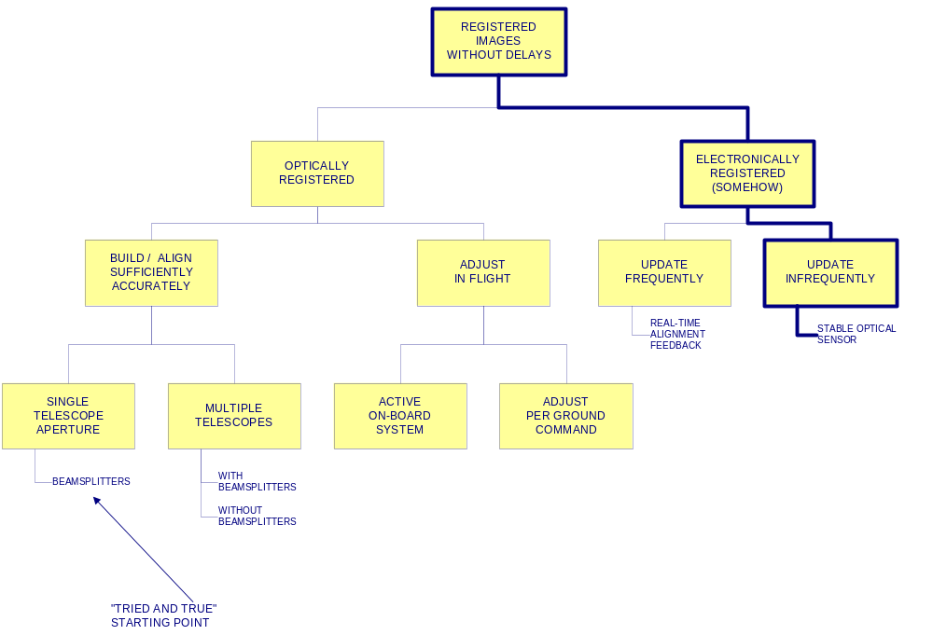
Narrowing Down the Options
PM/SE WS-<number>
Design concept selection
Notes:
NARROWING DOWN THE OPTIONS
Organising the options into a tree structure permits rapid convergence on the feasible ones. The various possibilities are grouped so that any suspected weak links appear high in the tree. That way, one calculation can “prune” a large section at once.
In this case this particular way of drawing the tree allowed the basic trade-off to be made without developing much detail in the candidate optical designs. All of the schemes for building and aligning the optics sufficiently accurately required similar numbers of parts with similarly tight mechanical tolerances. When all of the manufacturing issues were taken into account, it was clear that all of these schemes had unacceptable cost, schedule, and risk impacts. A similar analysis led to the same conclusions for schemes for mechanically adjusting things in flight.
Once these two branches had been lopped off, we had no alternative but to explore the electronically registered option. Fortunately we were able to develop a pipeline resampling processor that would meet the requirements. The choice between frequent of infrequent updating was a more detailed decision that we temporarily resolved in the most conservative direction, at least until our customer could get used to having an unfamiliar solution to his problem.
If the lasts branch had not been found to be feasible, the only conclusion that could be drawn is that this particular requirement really can’t be met. This would not be good news, but it is far better to know it and work with the customer to decide what to do earlier rather than later.
This way of presenting the trade-off logic can be extremely useful if you find yourself coming up with unexpected or unwelcome conclusions. The graphical presentation makes it easy for someone to grasp the overall picture quickly. You can invite your management or your customer to point out possibilities you’ve overlooked or where your logic has gone wrong. If they can, great! You have used this as a communication tool to help solve the problem. If your logic was correct, your audience is much more likely to accept and deal with the conclusion than to want to kill the messenger.

Slide 56
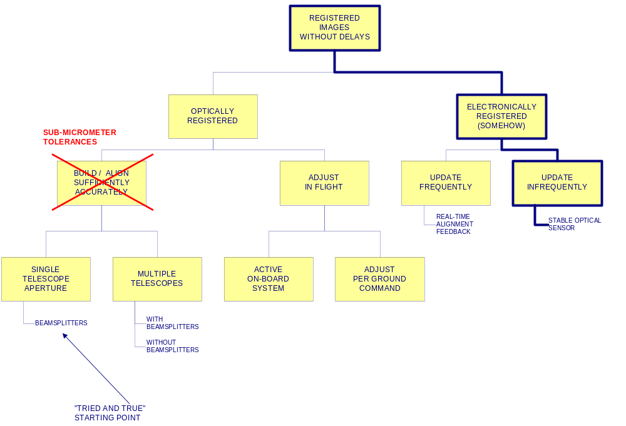
Narrowing Down the Options
PM/SE WS-<number>
Design concept selection
Notes:
NARROWING DOWN THE OPTIONS
Organising the options into a tree structure permits rapid convergence on the feasible ones. The various possibilities are grouped so that any suspected weak links appear high in the tree. That way, one calculation can “prune” a large section at once.
In this case this particular way of drawing the tree allowed the basic trade-off to be made without developing much detail in the candidate optical designs. All of the schemes for building and aligning the optics sufficiently accurately required similar numbers of parts with similarly tight mechanical tolerances. When all of the manufacturing issues were taken into account, it was clear that all of these schemes had unacceptable cost, schedule, and risk impacts. A similar analysis led to the same conclusions for schemes for mechanically adjusting things in flight.
Once these two branches had been lopped off, we had no alternative but to explore the electronically registered option. Fortunately we were able to develop a pipeline resampling processor that would meet the requirements. The choice between frequent of infrequent updating was a more detailed decision that we temporarily resolved in the most conservative direction, at least until our customer could get used to having an unfamiliar solution to his problem.
If the lasts branch had not been found to be feasible, the only conclusion that could be drawn is that this particular requirement really can’t be met. This would not be good news, but it is far better to know it and work with the customer to decide what to do earlier rather than later.
This way of presenting the trade-off logic can be extremely useful if you find yourself coming up with unexpected or unwelcome conclusions. The graphical presentation makes it easy for someone to grasp the overall picture quickly. You can invite your management or your customer to point out possibilities you’ve overlooked or where your logic has gone wrong. If they can, great! You have used this as a communication tool to help solve the problem. If your logic was correct, your audience is much more likely to accept and deal with the conclusion than to want to kill the messenger.

Slide 57
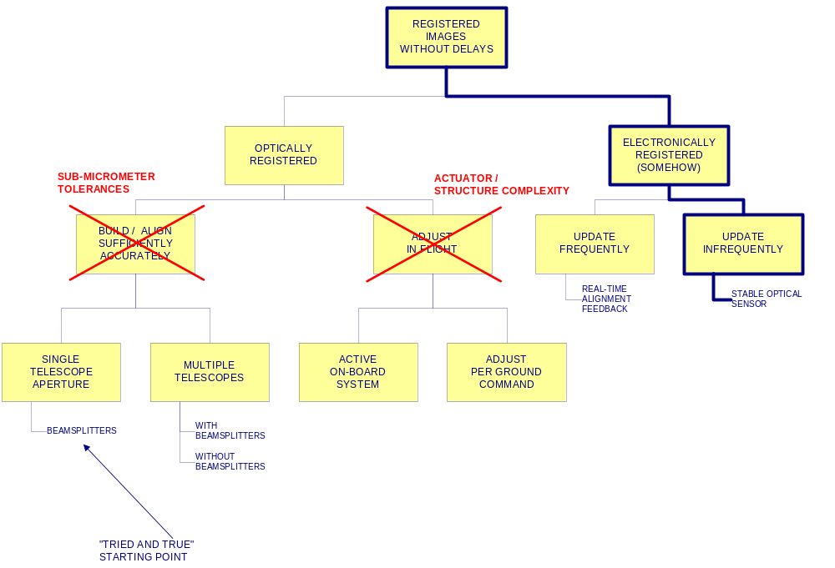
Narrowing Down the Options
PM/SE WS-<number>
Design concept selection
Notes:
NARROWING DOWN THE OPTIONS
Organising the options into a tree structure permits rapid convergence on the feasible ones. The various possibilities are grouped so that any suspected weak links appear high in the tree. That way, one calculation can “prune” a large section at once.
In this case this particular way of drawing the tree allowed the basic trade-off to be made without developing much detail in the candidate optical designs. All of the schemes for building and aligning the optics sufficiently accurately required similar numbers of parts with similarly tight mechanical tolerances. When all of the manufacturing issues were taken into account, it was clear that all of these schemes had unacceptable cost, schedule, and risk impacts. A similar analysis led to the same conclusions for schemes for mechanically adjusting things in flight.
Once these two branches had been lopped off, we had no alternative but to explore the electronically registered option. Fortunately we were able to develop a pipeline resampling processor that would meet the requirements. The choice between frequent of infrequent updating was a more detailed decision that we temporarily resolved in the most conservative direction, at least until our customer could get used to having an unfamiliar solution to his problem.
If the lasts branch had not been found to be feasible, the only conclusion that could be drawn is that this particular requirement really can’t be met. This would not be good news, but it is far better to know it and work with the customer to decide what to do earlier rather than later.
This way of presenting the trade-off logic can be extremely useful if you find yourself coming up with unexpected or unwelcome conclusions. The graphical presentation makes it easy for someone to grasp the overall picture quickly. You can invite your management or your customer to point out possibilities you’ve overlooked or where your logic has gone wrong. If they can, great! You have used this as a communication tool to help solve the problem. If your logic was correct, your audience is much more likely to accept and deal with the conclusion than to want to kill the messenger.

Slide 58
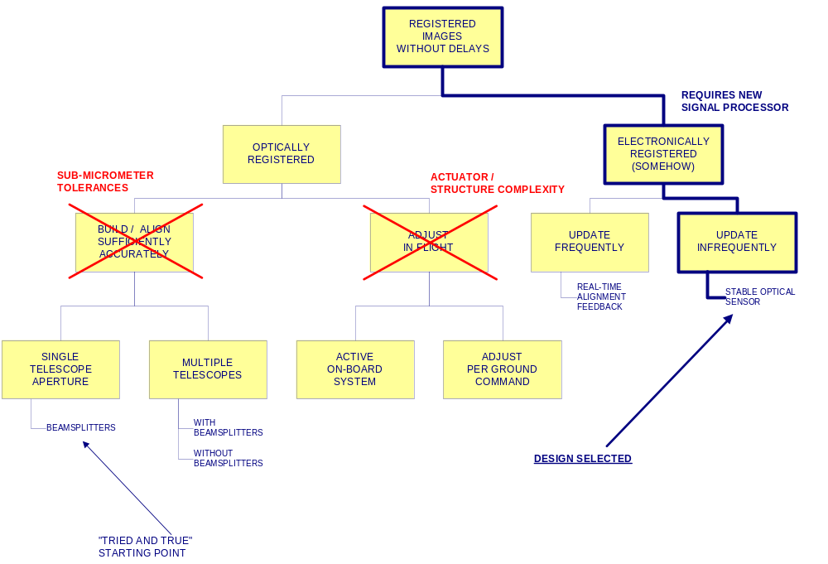
Narrowing Down the Options
PM/SE WS-<number>
Design concept selection
Notes:
NARROWING DOWN THE OPTIONS
Organising the options into a tree structure permits rapid convergence on the feasible ones. The various possibilities are grouped so that any suspected weak links appear high in the tree. That way, one calculation can “prune” a large section at once.
In this case this particular way of drawing the tree allowed the basic trade-off to be made without developing much detail in the candidate optical designs. All of the schemes for building and aligning the optics sufficiently accurately required similar numbers of parts with similarly tight mechanical tolerances. When all of the manufacturing issues were taken into account, it was clear that all of these schemes had unacceptable cost, schedule, and risk impacts. A similar analysis led to the same conclusions for schemes for mechanically adjusting things in flight.
Once these two branches had been lopped off, we had no alternative but to explore the electronically registered option. Fortunately we were able to develop a pipeline resampling processor that would meet the requirements. The choice between frequent of infrequent updating was a more detailed decision that we temporarily resolved in the most conservative direction, at least until our customer could get used to having an unfamiliar solution to his problem.
If the lasts branch had not been found to be feasible, the only conclusion that could be drawn is that this particular requirement really can’t be met. This would not be good news, but it is far better to know it and work with the customer to decide what to do earlier rather than later.
This way of presenting the trade-off logic can be extremely useful if you find yourself coming up with unexpected or unwelcome conclusions. The graphical presentation makes it easy for someone to grasp the overall picture quickly. You can invite your management or your customer to point out possibilities you’ve overlooked or where your logic has gone wrong. If they can, great! You have used this as a communication tool to help solve the problem. If your logic was correct, your audience is much more likely to accept and deal with the conclusion than to want to kill the messenger.

Slide 59
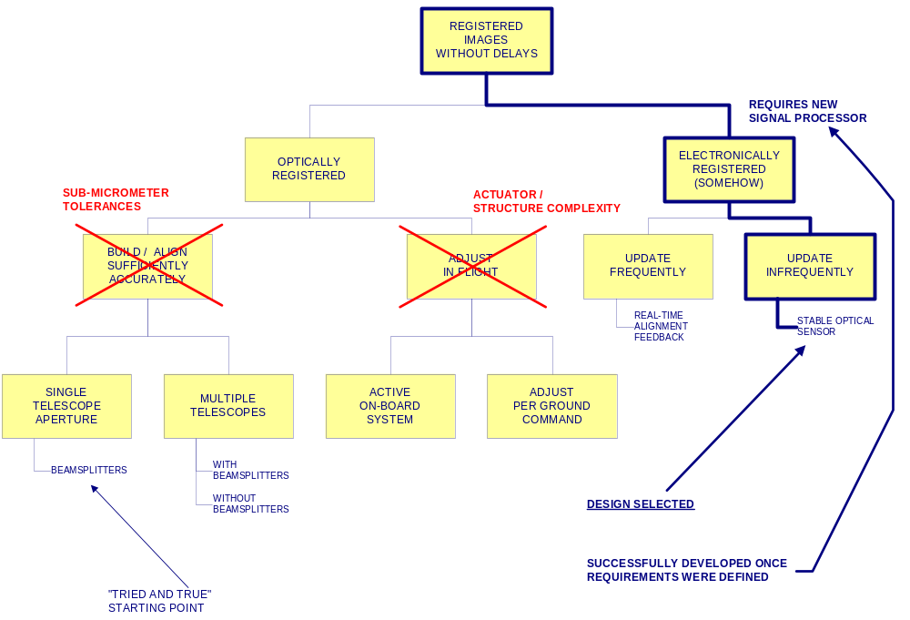
Narrowing Down the Options
PM/SE WS-<number>
Design concept selection
Notes:
NARROWING DOWN THE OPTIONS
Organising the options into a tree structure permits rapid convergence on the feasible ones. The various possibilities are grouped so that any suspected weak links appear high in the tree. That way, one calculation can “prune” a large section at once.
In this case this particular way of drawing the tree allowed the basic trade-off to be made without developing much detail in the candidate optical designs. All of the schemes for building and aligning the optics sufficiently accurately required similar numbers of parts with similarly tight mechanical tolerances. When all of the manufacturing issues were taken into account, it was clear that all of these schemes had unacceptable cost, schedule, and risk impacts. A similar analysis led to the same conclusions for schemes for mechanically adjusting things in flight.
Once these two branches had been lopped off, we had no alternative but to explore the electronically registered option. Fortunately we were able to develop a pipeline resampling processor that would meet the requirements. The choice between frequent of infrequent updating was a more detailed decision that we temporarily resolved in the most conservative direction, at least until our customer could get used to having an unfamiliar solution to his problem.
If the lasts branch had not been found to be feasible, the only conclusion that could be drawn is that this particular requirement really can’t be met. This would not be good news, but it is far better to know it and work with the customer to decide what to do earlier rather than later.
This way of presenting the trade-off logic can be extremely useful if you find yourself coming up with unexpected or unwelcome conclusions. The graphical presentation makes it easy for someone to grasp the overall picture quickly. You can invite your management or your customer to point out possibilities you’ve overlooked or where your logic has gone wrong. If they can, great! You have used this as a communication tool to help solve the problem. If your logic was correct, your audience is much more likely to accept and deal with the conclusion than to want to kill the messenger.

Slide 60
Comparing Feasible Candidates and Drawing the Conclusion
Write down trade-off criteria
  Killer requirements identified in initial requirements analysis
  Other system-level requirements in which the candidates differ significantly
  Additional selection criteria brought to light in analysing straw-man designs
Write down trade-off logic
  Relative weights of selection criteria
  Definitions of terms, performance classifications
  Anything else needed to accurately represent the logic you are using
Compare all candidates on the same basis
  Computed numbers (power, weight, etc.) where significant
  Use coarse scoring (e.g. excellent, good, etc.) to compare dissimilar traits
PM/SE WS-<number>
Design concept selection

Slide 61
Comparing Feasible Candidates and Drawing the Conclusion (2)
Beware of quantitative scoring schemes
  Does the algorithm have a logical basis? Or does it just “dress up” a subjective analysis?
  Are the component scores determined objectively?
  Does the end result violate common sense, or just reflect initial prejudices?
  Numerical scoring does not relieve you of responsibility for sound logic and judgement
Output: Selected conceptual design
PM/SE WS-<number>
Design concept selection

Slide 62
Recording/Presenting the Results
Three goals:
  See your own logic objectively so you can check it/improve it
  Explain it to your customer so he can understand it/check it/believe it
  Record your logic so you can revise it easily if circumstances change later on
Present it in the way that is easiest to understand - hierarchically
  Top-level summary first
  Explain the logic used, not just the technical facts
  Add detail only as needed to justify conclusion
PM/SE WS-<number>
Design concept selection

Slide 63
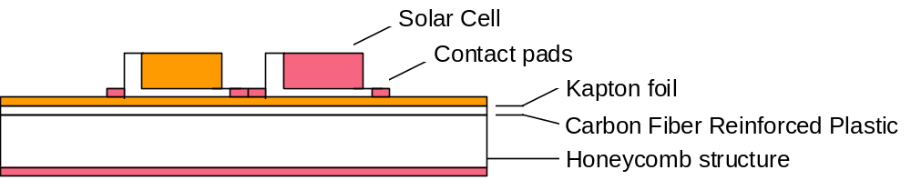
Example: Solar Array Face Sheet Material Isolation Layer
Solar arrays consist of
  Solar cells
  Kapton foil for electrical isolation
  Honey comb structure with CFRP skin (conducting)
Design issue: Solution for in flight short circuit of solar cells to CFRP skin
  Contractor: “Increase thickness Kapton film to 50 micrometer”
  Customer: “Replace CFRP with Kevlar (intrinsic isolator)”
  Two other possible solutions were offered
PM/SE WS-<number>

Slide 64
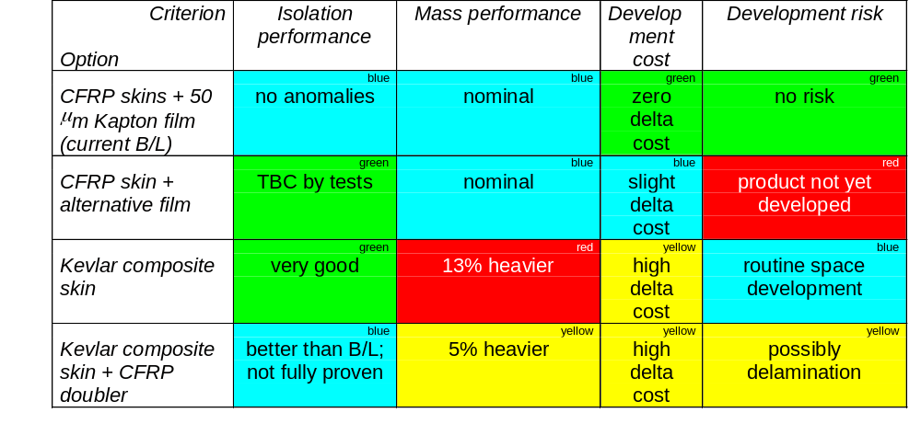
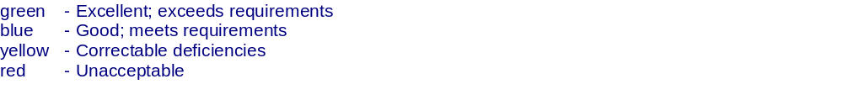
One style of Summary Trade-off Table
Column widths proportional to weight of criteria
Reason for each judgement summarized in box
Score classifications defined clearly
Color used for oral presentation; labels convey information in b/w copy
Conclusion clear: Current B/L
PM/SE WS-<number>
Design concept selection

Slide 65
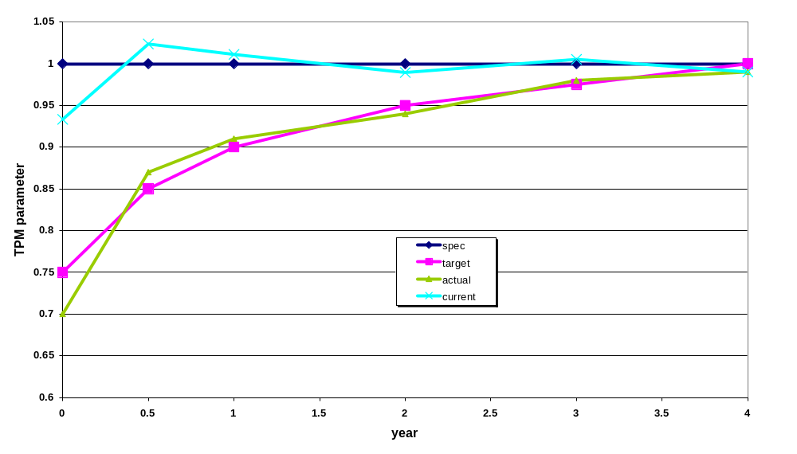
Technical resource budgets
Compiled for requirements that are always important (and generally give great trouble)
  Spacecraft example
    Mass
    On-board computer capacity
    Electrical power
    Structural stiffness
    Pointing (error)
    Delta V
    Propellant mass
    Communication link
    Envelope / size
    (Series) production cost
PM/SE WS-<number>
Technical resource budgets

Slide 66
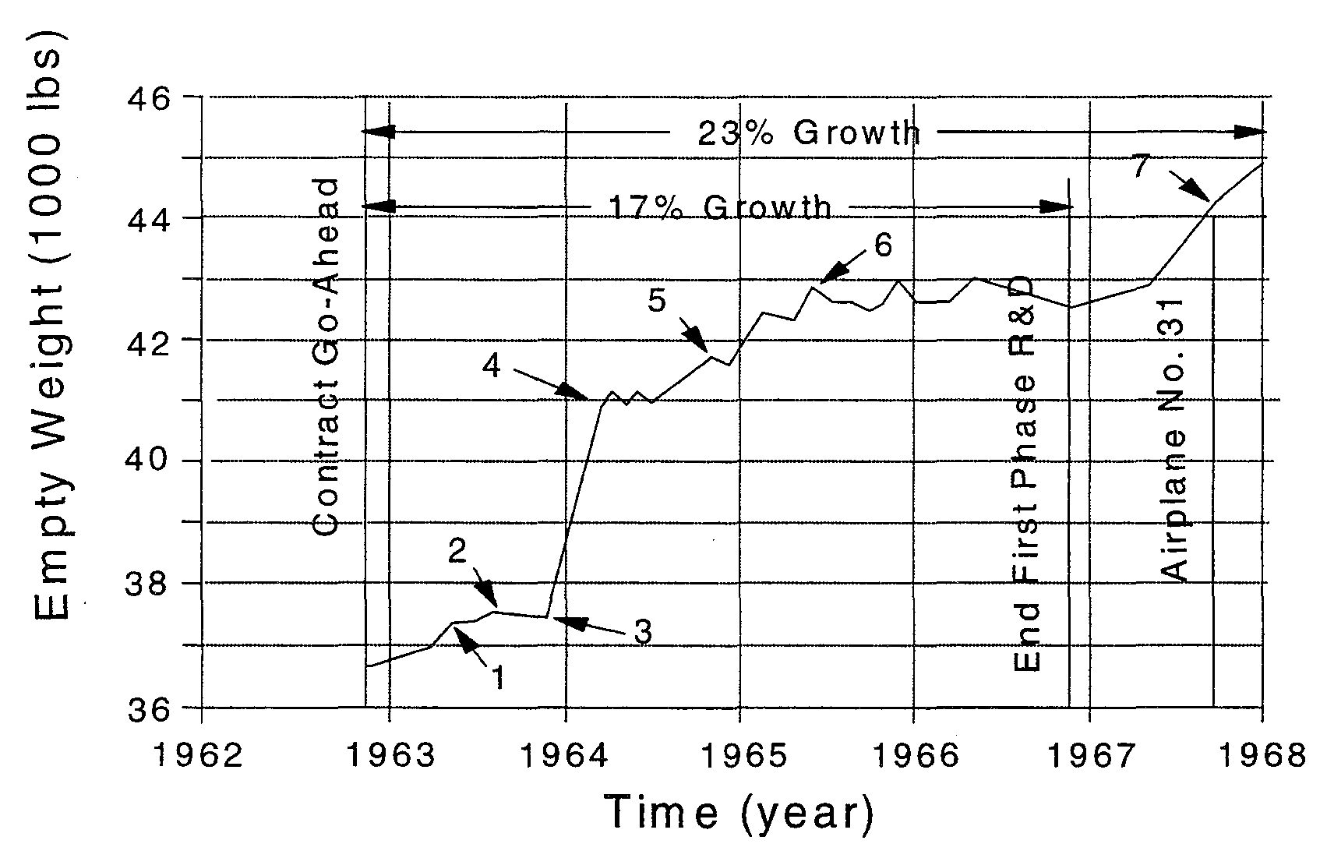
Exist also for aircraft, are not always used, but still are useful
(Empty) mass
On-board computer capacity*
Aircraft availability (dispatch reliability, turn-around-time)
(Cruise) drag
Envelope / (internal) space / useable fuel capacity
Center of gravity location
Thrust (take-off, continuous, climb)
Take-off/ landing maximum lift
F-111
Series production cost
Cruise specific fuel consumption
Direct maintenance cost
PM/SE WS-<number>
* Military aircraft; civil not yet
Technical resource budgets

Slide 67
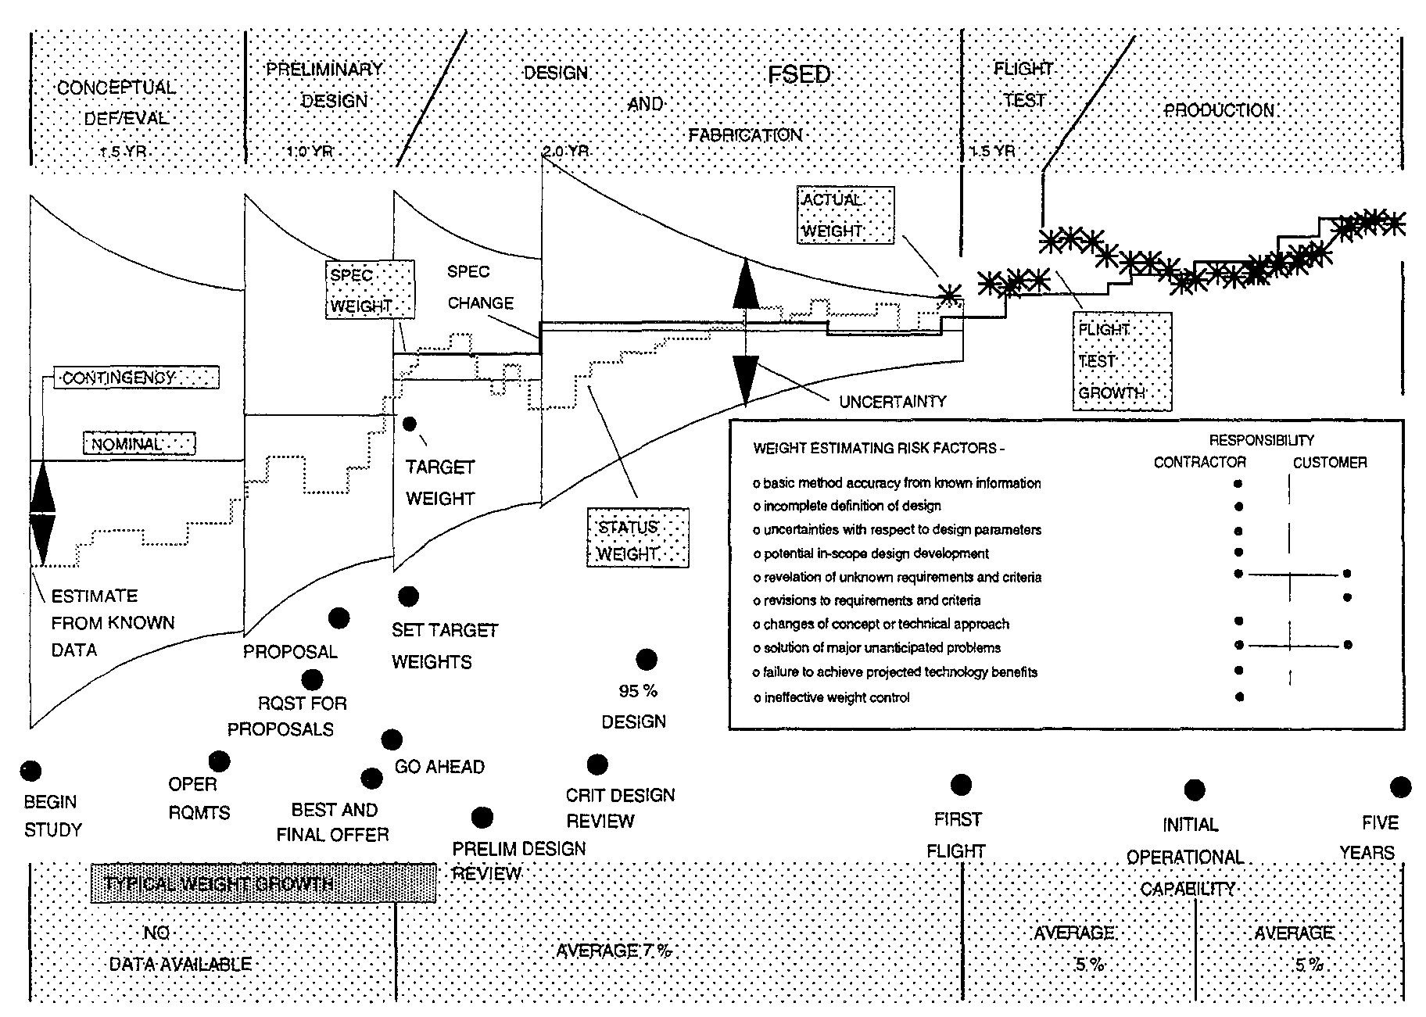
And some details …..
PM/SE WS-<number>
Technical resource budgets

Slide 68
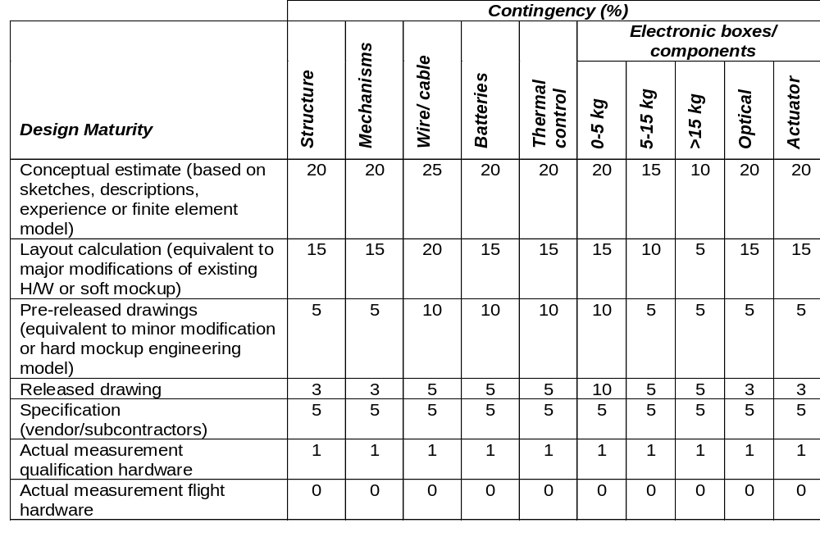
Example: S/C mass contingency allowance
PM/SE WS-<number>
Technical resource budgets

Slide 69
TPM procedure
Objective
  Ensure that product achieves specified performance at delivery
Method
  Plan the “allowed” value of specific parameters over the life time
How?
  Get specification value (which includes any contingency you may need)
  Construct a target value (equal to specification value minus a contingency derived from previous similar product developments)
  Get actual value of parameter as best as you can establish it (this excludes any uncertainty, so it is without contingency)
  Construct a current value (equal to actual value including a contingency, reflecting on the actual status of the design, again derived from previous similar product developments)
This is the monitoring part of the procedure
PM/SE WS-<number>
Technical resource budgets

Slide 70
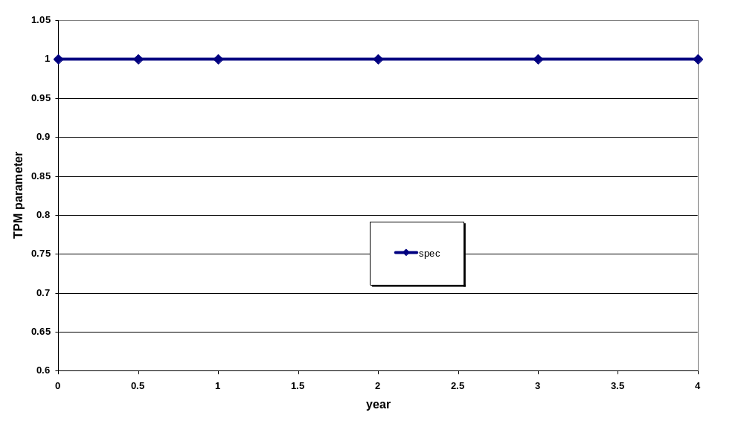
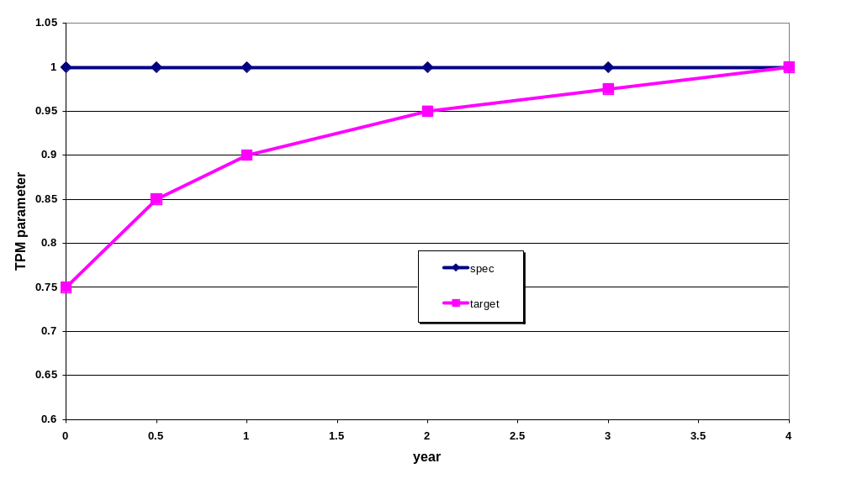
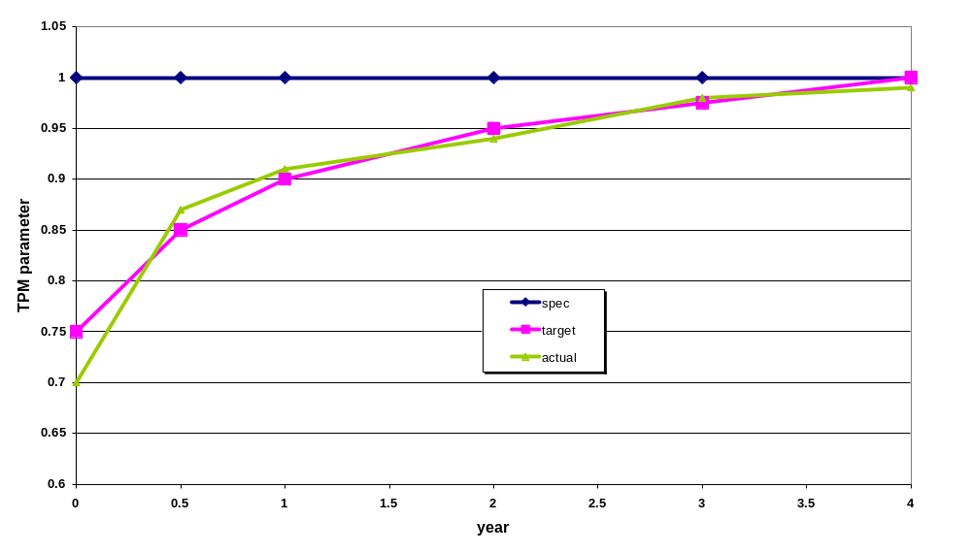
TPM procedure graphically
ACTION
OSO 2007-2008
PM/SE WS-<number>
Technical resource budgets

Slide 71
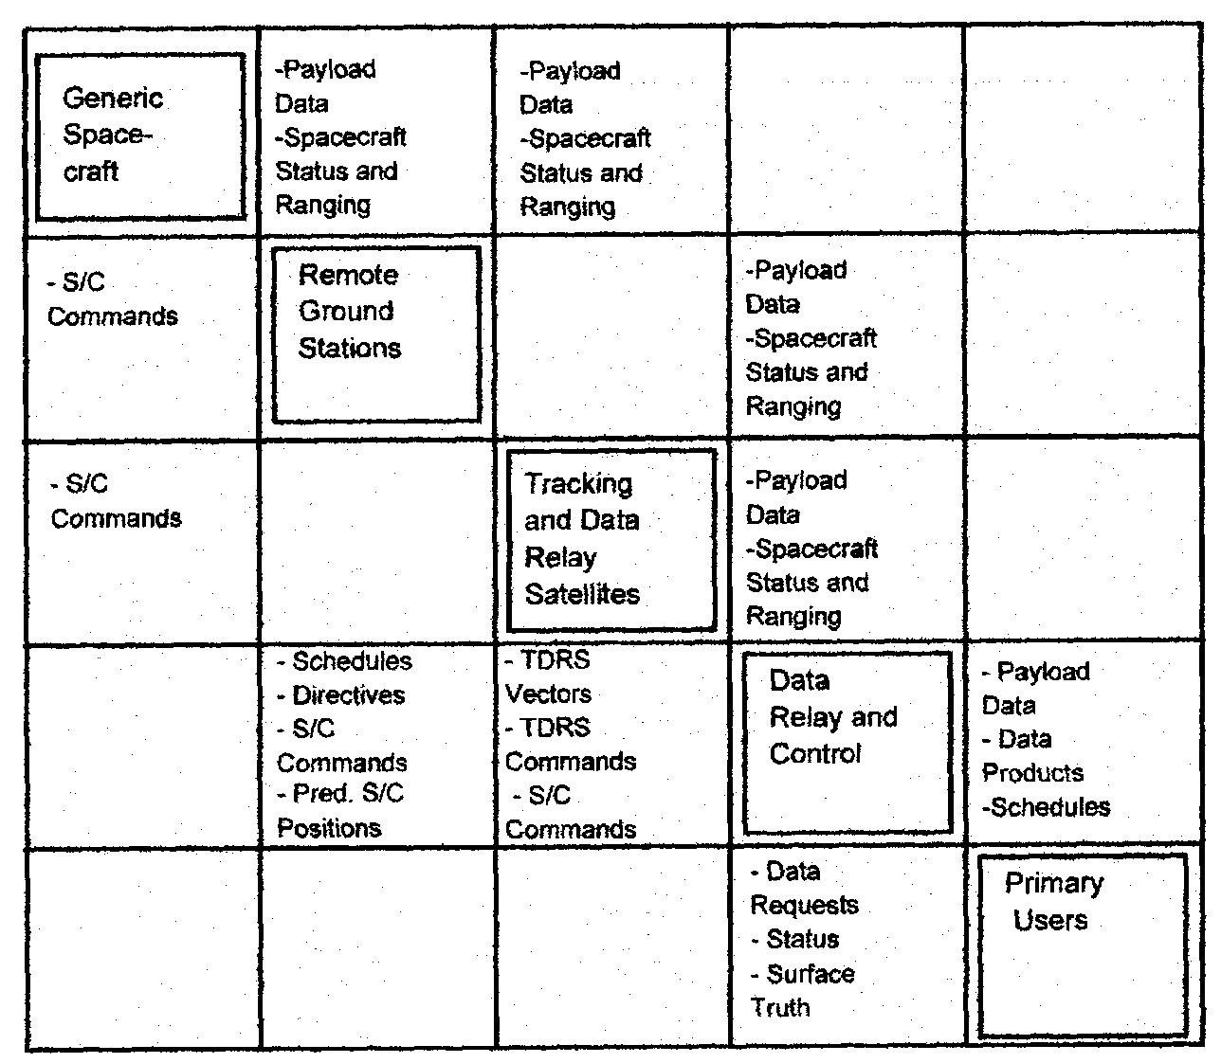
Interface Identification – N² Chart
S/C
Spacecraft
TDRS
Tracking & Data Relay Satellite
PM/SE WS-<number>

Slide 72
Interface Identification – N² Chart
elements/
functions
S/C
Spacecraft
TDRS
Tracking & Data Relay Satellite
PM/SE WS-<number>

Slide 73
Interface Identification – N² Chart
output
elements/
functions
input
input
S/C
Spacecraft
TDRS
Tracking & Data Relay Satellite
output
PM/SE WS-<number>

Slide 74
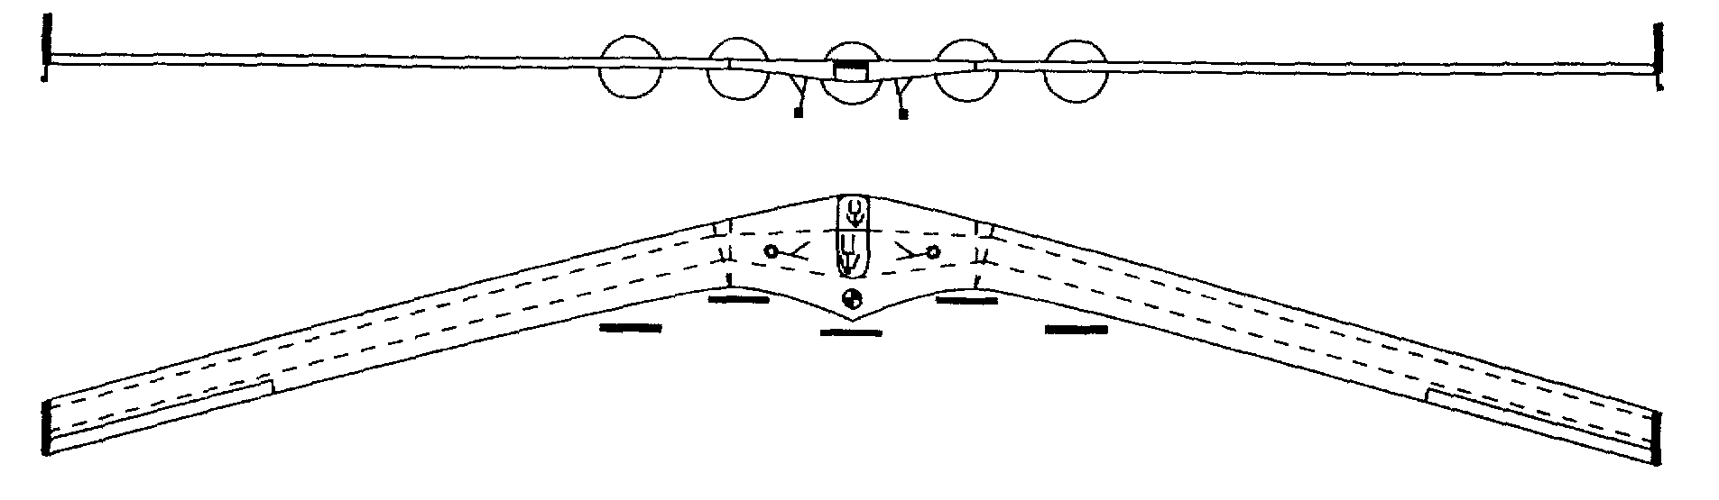
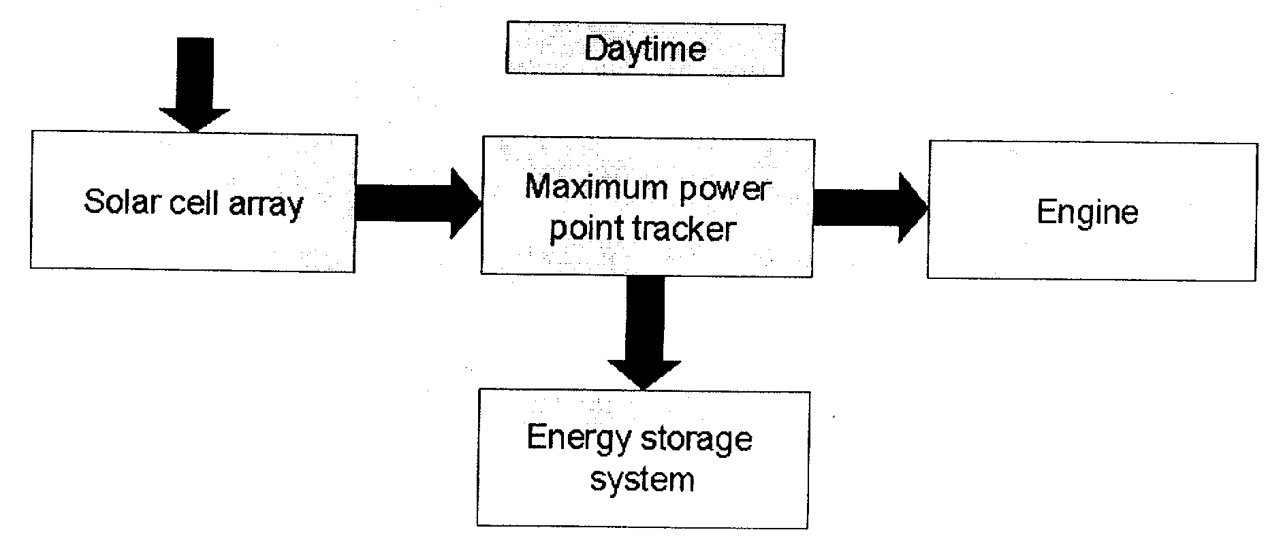

Reporting your preferred design: pictures and a few text
Often better than long descriptions
Of course physical configuration sketches
But also block diagrams
Source: DSE “Horizon, solar–powered
flight around the world”
PM/SE WS-<number>
Design concept description

Slide 75


Reporting your preferred design: pictures and a few text (2)
Example:
Functional block diagram of a missile fin control system
PM/SE WS-<number>
Design concept description

Slide 76

Reporting your preferred design: pictures and a few text (3)
PM/SE WS-<number>
Design concept description

Slide 77

Reporting your preferred design: pictures and a few text (4)
PM/SE WS-<number>
Design concept description

Slide 78
Development logic and cost estimate
You will have to define the design & development logic for and to estimate the cost of your product
  Design & development logic: same components as you initially made for this Design Synthesis exercise, but than for future activities
    activity flows
    Work Breakdown Structure
    work phases
    schedule/Gantt chart
  Cost estimate: Use sources as specified in ae3-S01
    Launch vehicles
      Koelle, D.E.; Handbook of Cost Engineering for Space Transportation Systems with Transcost
    Aircraft, spacecraft, engines, launchers, etc.
      NASA Cost Estimating, http://www.jsc.nasa.gov/bu2/
    Spacecraft
      Wertz & Larson, Space Mission Analysis and Design
PM/SE WS-<number>
Development logic & cost estimate

Slide 79
Some guidelines …..
Scope of the design and development logic
  as for the Design Synthesis exercise (limit to 5 pages)
For the cost estimate
  Pay attention to acquisition cost and Life Cycle Cost
Use parametric cost models with care
  Read the instructions well
  Decide whether assumptions and approximations made agree with yours
  Correct results for the year you are calculating the cost for
PM/SE WS-<number>
Development logic & cost estimate

